Slide 1



Pedagogy and Classroom Management

Slide 2
Day 1
What we are learning today
Understand the different school process contributing to learning
Understand the importance of school in enabling learning
Understanding aims of schooling and its processes

Slide 3
Activity 1
Listening to a radio Show
Watching a Television
Walking on the Street
Having Food
Interacting in a group
Playing football with Friends

Slide 4
Activity 1 conclusion:
We have same senses, we use these senses differently for experiencing world.
Because we use our senses differently to experience the world, our learning is always subjective from the same experience.
The act of learning is always dynamic, subjective and always evolving. The way we experience first live cricket watching experience evolves over the period of time.
The diversity in learning and experience needs to be empathise rather to be rejected.
Therefore, as supervisor, we need to support teachers in addressing these learning diversity of class and enable teachers to create better learning opportunities for learning.

Slide 5
Activity 2: What classroom stands for:
How learning happens in classroom?
Students only learns from teachers?
How students learn from their peers?
Do students learns from the enabling environment created for learning?

Slide 6
What classroom stands for:
Classroom stands for different opportunities for learners to learn
  Learning from the instruction provided by teachers
  Learning from scaffolding provided by teacher
  Learning from the question posed by teacher
  Learning from using their own peers
  Learning from the study materials provided
As supervisor,
Support teacher in creating different types of opportunities to learn within lesson plan facilitation.

Slide 7
What is the role of teacher in socialisation of student?
Is classroom only enable “curriculum learning”?
What are the different types of learning opportunities for students?
How can teacher ensure better socialisation?

Slide 8
Role of teacher in socialisation of student?
Classroom only enable “curriculum/ textbook learning”?
Teacher can provide different opportunities student to learn beyond textbook.
  Ensuring learning using the student background knowledge
  Ensuring learning using environment
  Ensuring learning from using different views of students
As supervisor:
To support teacher in ensuring students not just learn textbook objectives but also learn to understand their peers, their teachers and get opportunities to participate and interact within the classroom.
This enables students not just as active participants in their learning but also supports in socialising better within and outside classroom.

Slide 9
Identify the various educational activities that are carried out in schools with a purpose.
Playing together in playground contributes to..
  Supports in developing physical development of students
  Understanding rules and discipline of the games
  Coordination with each other
  Peer learning
  Understanding failure and success
  Communication skills
  Respecting diversity
Similarly discuss,
Assembly contributes to…
Library contributes to…
Celebrating different festivals contributes to….

Slide 10
We discussed different educational activities that carried out in schools with a purpose.
Schooling contributes to providing different learning opportunities and processes which support student to develop their cognitive, physical as well social skills.
As a supervisor,
Our responsibility is to support schooling staff in ensuring qualitative experience of the students to have holistic development by accessing different learning opportunities.

Slide 11
So far, we have discussed and reflected on the different learning opportunities from classroom and other schooling process.
Lets understand National Strategic and Education Plan aims at

Slide 12
National Education Strategic Plan of Afghanistan 2017-2021 states its goal as
“Our vision is to facilitate the development of vibrant human capital by providing equal access to quality education for all and enable our people to participate and contribute productively to the development, economic growth and stability of our country”.

Slide 13
National Education Strategic Plan of Afghanistan goal statement
What do you understand from the goal statement?
How do you see your role in ensuring these goal fulfillment?
Role of supervisor in contributing to education goal : ___________________________________________________________________________________________________________________________________________________________________________________________________________

Slide 14
National Education Strategic Plan of Afghanistan goal statement
What do you understand from the goal statement?
  Focus on equal access to quality of education
  Development of citizen as productive contributor to development and economic growth and stability of the county
How do you see your role in ensuring these goal fulfillment?
  Ensuring equal access to quality education
  Enable our people to participate and contribute productively to the development, economic growth and stability of our country.
  Role of supervisor in contributing to education goal :
Provide monitoring and supervising support to school in ensuring quality access of education
Providing support to school in developing student as productive citizen by developing their knowledge, skills and perspective

Slide 15
National Education Strategic Plan of Afghanistan goal statement
Focus on equal access to quality of education
Development of citizen as productive contributor to development and economic growth of the county
How do you see your role in ensuring these goal fulfillment as supervisor?
  development of vibrant human capital by providing equal access to quality education
  enable our people to participate and contribute productively to the development, economic growth and stability of our country.

Slide 16
Day 2
What we are learning today
To Understand the learning theories to approach active learning.
To Understand the importance of active learning in classroom Processes.

Slide 17
Day 2
What we are learning today
To Understand the learning theories to approach active learning.
To Understand the importance of active learning in classroom Processes.

Slide 18
Activity 1: Learner’s Agency
Objective: To engage participants on what factors contribute to an active learning environment where the student as well as Teachers voice is reflected in all aspects in the learning space.

Slide 19
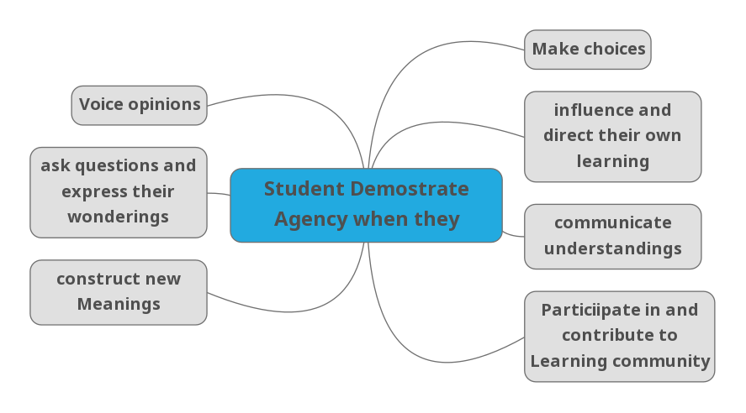

Slide 20
Activity 2:
Objective of the Activity: To Explain process of learning through social interaction as being in the Zone of Proximal Development (ZPD) in Classroom.

Slide 21
Activity 3:
Objective of the Activity: To Explain process of learning through stage of development, So participants can analyze classroom learning.

Slide 22
Structured Reflection (35 mins)
The diaries will be distributed to the facilitators along with the prompts for feedback on the training:
Prompts
Did you enjoy the activities?
What did you learn about in today’s training?
What would you change about today’s training? Etc.
Directions
Supervisors, please write your notes for the facilitators in the diaries. These will then be collected.
The trainers will respond to the diary entries by writing back. You will get the diaries back tomorrow.

Slide 23
Day 3: Pedagogy of Language
What we are learning today
Understanding the nature of learning language and its implication in classroom teaching of language.
Participants will understand the key attributes of a language learning classroom.

Slide 24
Activity 1
Activity 1: Video based discussion (90 min)
Objective of the Activity: To develop understanding of what learning language objectives are.

Slide 25
Discussion on nature of language learning and its implication on classroom teaching of language learning
(60 Mins)
To understand “language learning” in the schooling scenario, here are the four critical aspects which the Trainer needs to discuss to sensitise participants towards the importance of language learning in schooling. There are:
Understanding nature of language learning
Understanding importance of deliberate instruction for language learning
Critical consideration for language learning form pedagogical context
How language learning is critical for learning every other curricular subject.

Slide 26
Activity 2
Objective of the Activity: understand the key attributes which enables a language learning process more constructive and learner centric.

Slide 27
Activity 3
Objective of the Activity:
Understanding the positioning of language classrooms in the subject hierarchy.

Slide 28
Structured Reflection (35 mins)
The diaries will be distributed to the facilitators along with the prompts for feedback on the training:
Prompts
Did you enjoy the activities?
What did you learn about in today’s training?
What would you change about today’s training? Etc.
Directions
Supervisors, please write your notes for the facilitators in the diaries. These will then be collected.
The trainers will respond to the diary entries by writing back. You will get the diaries back tomorrow.

Slide 29
Day 4: Pedagogy of Mathematics
What we are learning today
After going through this unit, Participants will be able to
Understand aims of teaching and learning mathematics education.
Identify the indicators of effective mathematics education.
Create a conducive learning environment in the school for Mathematization.

Slide 30
Activity 1
Activity 1: Why Mathematics?

Slide 31
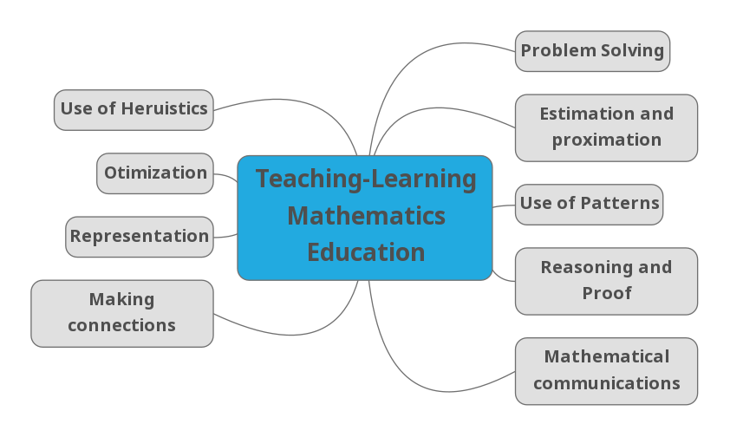

Slide 32
Activity 2 Understanding the usages of different materials and tools which can be used to solve mathematical problems.
To Understanding the usages of different materials and tools which can be used to solve mathematical problems.

Slide 33
Activity 3: Structure discussion around Video
Objective: To Understanding the usages of different materials and tools which can be used to solve mathematical problems.

Slide 34
Activity 4: Structured Reflection
How did ancient Mathematics contribute to modern day life?
How does Mathematics affect our daily lives? (While cooking: by using ingredient we use promotional reasoning, All kind of Transaction with Bank, at Market to buy groceries, Fruits etc. )
Why are women underrepresented in Mathematics fields ?
Is there some new way in which the teacher can present a concept in order to make it more meaningful and more interesting?
What activities, demonstrations, teaching aids, etc. would enrich the classroom presentation? (Take any textbook example)
How can you support Maths teachers as part of your responsibility? (Your own preparation, Strategies with reference to National Goal)

Slide 35
Day 5: Pedagogy of Science
What we are learning today
Objectives of the day are to help Participants in:
Understanding the nature of science and its place in school curriculum,
Understanding the importance of scientific temper development among all learners.

Slide 36
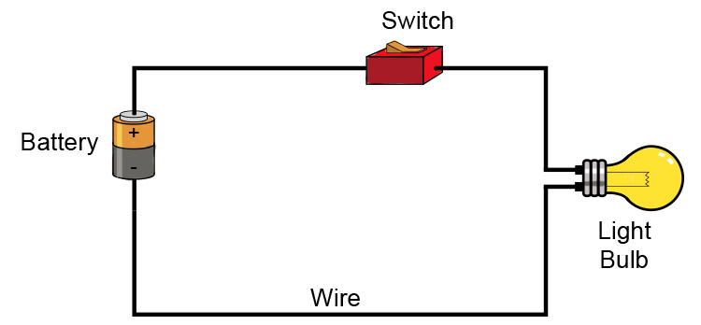
Activity 1: Scientific process
The bulb Glow if the Wire Materials is
iron
copper
Aluminium
Silver
Gold
Mercury
Pencil Lead
Graphite (Non Metal)

Slide 37
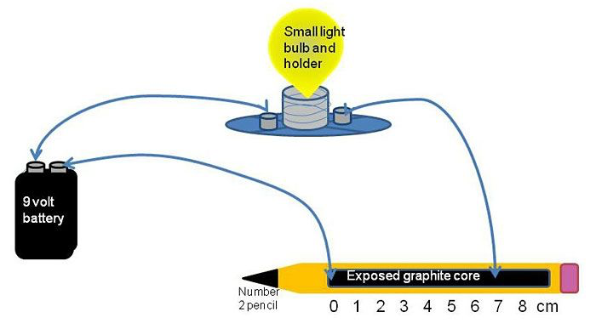
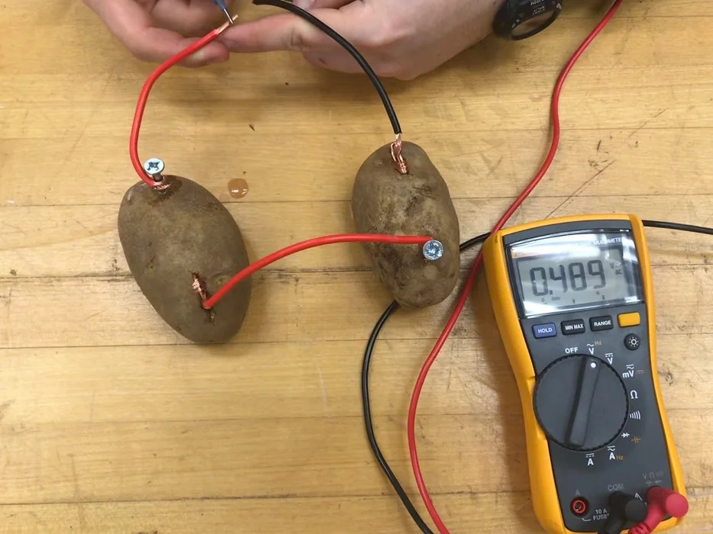
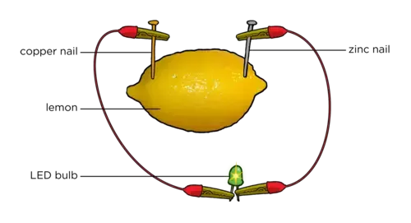
Activity 1:

Slide 38
Activity 2: Perspective: Science Education
Objective: Understanding the perspective of the Science classroom.
Body of Knowledge
Inquiry
way of thinking

Slide 39
Activity 3: Science and Society
Activity: Identify the factors that encourage girls to pursue Science and Allied field careers.
Triggered Questions:
What stereotypes exist about girls pursuing careers in science and allied fields?
How do those stereotypes specifically affect girls in schools?
What actions do you propose to get more girls into Science and Allied field careers?

Slide 40
Day 6: Pedagogy of Social Science
What we are learning today
Understanding the core objective of teaching social science in the school.
Understanding the skills and prospective social science curriculum should strengthen students.
Understanding different pedagogical tools/ methods for social science pedagogy.

Slide 41
Activity 1:
Activity 1: Discussion on understanding social science as a subject.
What do you understand from social science as a subject?

Slide 42
Activity 2:
Activity 2: Understanding different skills and values social science contributes in student development.
What are the skills social science teachers focus on building while teaching social science?
(Participants will select history, geography or civics curriculum to identify and articulate the skills required)

Slide 43
Activity 3:
Activity 3: Understanding different pedagogical tools/ methods and its usage for social science pedagogy.
Activity: Why Local Election Matters

Slide 44
Activity 4:
Activity 4: Structure reflection

Slide 45
Day 7: Learning objectives and Approach to lesson Plan
What we are learning today
Understanding on how to articulate learning objectives. with Stakeholders (Teachers, School head, students, Parents)
Collaborate with different stakeholders to define, design and implement intervention based on learning objectives.

Slide 46
Activity 1: What Constitute Learning Objectives?
SL No. | Statement (Learner will be able to...) | Specific (Yes/No) | Measurable (Yes/No) | Learning Outcomes (Yes/No)
1 | Draw the structure of Human Heart
2 | Write the Names of the country in order to their Proximity to Afghanistan.
3 | Favour the policies of the world health organisation.
4 | Study the given scenario to understand the function of the Afghanistan tax system.
5 | Use the given self-study materials to understand the various public policies in Afghanistan School education.
6. | Apply Microsoft Excel tool to manage School level documentation.
7 | Discuss ways to improve staff room culture.
8 | Support the vaccination policy of the government.
9 | Show a positive attitude towards juniors.

Slide 47
Activity 2: Understanding Bloom’s Taxonomy
SL No. | Statements | Bloom’s Level of Learning | Why?
1 | Describe the communication cycle between school and community.
2 | Recall the formula for calculating percentage.
3 | Analyse the different views measuring centigrade into Fahrenheit.
4 | Predict the new entrant in the school based on last year's community engagement.
5 | Propose five questions for Teacher-Parents interaction.
6 | Copying spin Bowling of Afghanistan Cricket Player Rashid Khan.
7 | Use operant conditioning principles in designing a reward system for children.
8 | Assess the quality of farm produce because of weather.
9 | State a memory requirement for approaching a Quadratic equation.
10 | Decide which article should be published in your school newsletter.

Slide 48
Activity 3: Connecting the Bloom’s taxonomy to various school context & academic subjects.
SL No. | Statements | Bloom’s Level of Learning
1 | Recall the seven wonders of the world. (Change the objective into Level 2) | Locate the seven wonders of the world on the world map.
2 | Apply BODMAS (Brackets, Orders, Division/Multiplication, Addition/Subtraction) rule to solve a given problem | Change the objective into Level I
3 | Propose a strategy to retain students in schools. | Change the objective into Level VI
4 | List three properties of Atoms and Molecules. | Change the objective into Level IV
5 | Recall the timetable changes of your school | Change the objective into Level V
6 | Use appropriate group dynamic skills to secure corporation among teachers | Change the objective into Level I
7 | Evaluate a growth of students in Learning Mathematics | Change the objective into Level III
8 | Analyse a Afghanistan Education Department campaign that convey stability and reliability | Change the objective into Level V
9 | Select Toys for your School children | Change the objective into Level VI
10 | Select the article that will be printed in the next issue of newsletter | Change the objective into Level I

Slide 49
Activity 4:
Activity 4: Structure reflection

Slide 50
Day 8: School Management
What we are learning today
Continuously learning and demonstrating the ability to solve complex problems.
Create effective and innovative solutions around pedagogy.
Create learning and growth opportunities for people, processes and institutions.

Slide 51
Activity
Caselet 1
Caselet 2
Caselet 3
Caselet 4
Caselet 5

Slide 52
Day 9: Observation and Classroom Management
What we are learning today
Guide and support school administrators and teachers on development of strategy to achieve NESP III Goals.
Create and enable a learning culture with measures and processes that support development of school staff.

Slide 53
Activities
Activity 1: Why is Perspective Talking Crucial in School/ Classroom? (90 Mins)
Activity 2: Positive Attitude towards Self and Others (90 Mins)
Activity 3: Empathy (90 Mins)
Activity 4: Structured Reflection (90 Mins)

Slide 54
Day 10: well-being
What we are learning today
Create an environment in schools/classrooms where everyone feels accepted, confident, cared for and are concerned about each other’s well-being

Slide 55
Activity
Activity 1: What “Management” is required for Managing a classroom? (90 Mins)
Activity 2: To understand the practices/actions we consciously or unconsciously have been engaging in managing the classroom. (90 Mins)
Activity 3: To demonstrate critical thinking for managing the classroom effectively. (90 Mins)
Activity 4: Structured reflection of the day (60 Mins)

