Slide 1



Inclusive Schools
Day 2
Exclusion as a barrier
Notes:
Facilitator’s Objective of Day 2: Exclusion as a barrier
Communicate that some barriers are visible (explicit biases), and some are invisible(implicit biases).
Mere integration is not inclusion
The difference in strategies and outcomes when learner is considered problematic and when school is considered to be problematic.
Prerequisite knowledge/skills for Facilitator:
1.Barriers are either visible or invisible
2.Exclusion is an invisible bias- generally happens due to social and cultural constructs
3. Familiar with different barriers in Afghan and in other developed and developing countries
4. Knowledge of various interventions, their strategies and outcomes to promote inclusivity in Afghanistan
5. Able to communicate to the participants that the barriers can be controlled or minimized at various levels,.
6. Able to help participants understand to segregate the issues of inclusion as those at which they can themselves address and the issues which can be address at the central level . 7. Able to enable the participants to understand how to document and report ground level issues to higher levels
Recommended literature for facilitators for prereading:
https://www.learningforjustice.org/professional-development/test-yourself-for-hidden-bias
https://www.unicef.org/rosa/media/5491/file/Afghanistan%20%E2%80%93%20Education%20Equity%20Profile%20for%20Adolescent%20Girls.pdf
https://www.unicef.org/education/inclusive-education Inclusive education | UNICEF
What are some examples of implicit bias? – Mvorganizing.org
https://jillianstarrteaching.com/inclusive-literacy-centers/

Slide 2
Day | Sub-topic | Concepts | Pedagogy | Time
Day 2 | Sub Competencies mapped: Problem solving and decision making
 | Exclusion in School: gender and child protection issues | Concept 2: Barriers due to Exclusion: Explicit and Implicit Biases Prejudice, Stereotypes, Discrimination | Welcome and Community building activity | 30 mins
 |  |  | Review of day 1:indicators of barriers | 20 mins
 |  |  | Concept of Exclusion and Kinds of exclusion | 20 min
 |  |  | Role play: visible and invisible bias | 20 min
 |  |  | Short Break | 10 mins
 |  |  | Explicit and Implicit biases | 40 mins
 |  |  | Gender stereotypes- 1 and 2 | 40 mins
 |  |  | Lunch | 60 mins
 |  |  | Where is the problem? In Student or In School? | 40 mins
 |  |  | Inclusive Literacy Classroom | 40 mins
 |  |  | Interactive presentation on literacy in inclusive classroom | 10 mins
 |  |  | Short Break | 10 mins
 |  |  | Identifying indicators of inclusivity | 20 mins
 |  |  | Reading case study | 20 mins
 |  |  | Structured reflection for the day | 40 mins
Notes:
Facilitator or Trainer: Soon after formal greeting, introduce the participants to the day’s schedule and move on to community building activity.

Slide 3
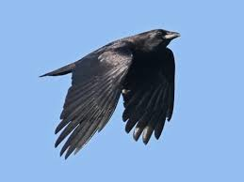
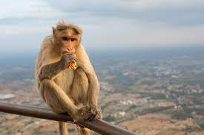
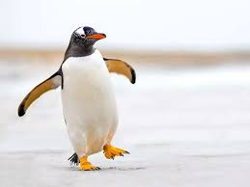
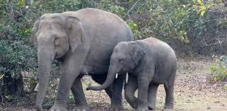

Community building activity: What is fair?
crow, monkey, penguin, elephant, fish,
Notes:
Facilitator:
In this community building exercise: What is fair?
Objective is to experience exclusion by the participants.
Materials: pen with each participant, chits of paper: on which names of animals are written (alternately pictures, miniatures, sounds of animals can be used), ppt slide with the picture.
Part 1: Activity:
Participants will gather around a circle:
One participant is chosen as teacher: The participant playing the role of a teacher gets the instruction cards to enact as teacher in a formal school.
In the following order each participant calls out name of one animal-crow, monkey, penguin, elephant, fish.
All the crows, monkeys, penguins, elephants and fish stand one beside the other forming a large circle
In the paper on the top, you write the animal you are.
Instruction: All the animals should do what the teacher asks you to do. If you cannot do, you have to come out of the circle and each time you cannot do, you will move two steps back away from the circle. And write on the paper I cannot ….….. But If you, can do what the teacher says you just enter the circle.
The participants will now do as the teacher says. If they, cannot they move two steps back. If they, can they enter the circle.
All of you jump.
All of you turn around in the same place where you are. (all can)
All of you swim.
All of you sing. (fishes go out)
All of you stand on four legs (penguin and crow go out)
All of you who have long nose (elephants stay on, monkeys move out)
All of you eat with both hands. (only monkeys move in, elephants move out)
All of you turn your head 360 degrees. (even monkey comes out)
Observation is that gradually the number depletes until no one remains except the teacher. This teacher must now enact that he/she is totally confused and announce that no one is getting admitted to the school and hence they plan to close the school.
.Ask participants: “read what you noted on your paper” observe that every statement begins with “I cannot……….. ”. Now pictorially draw an emoticon showing how you are feeling/ would feel if you were really a student at this school. After drawing pin, it to the chart paper

Slide 4
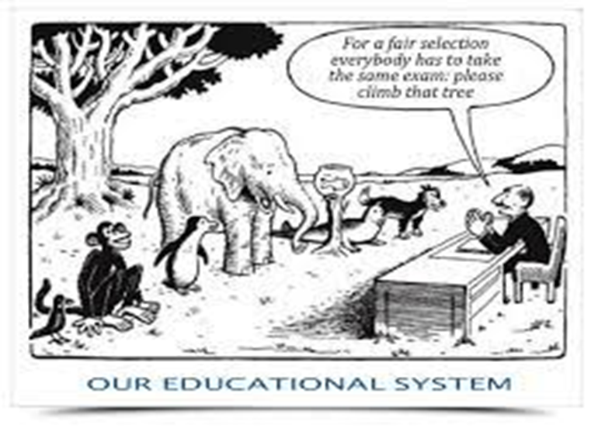
Animal school-What is fair?
Notes:
Part 2: After the activity let the participants get back to their seats. Discussion and reflection about the activity is carried out.
Draw their attention to the cartoon above where the teacher is conducting a fair examination and is asking them to climb the tree for FAIR selection.
Ask the participants to reflect on this activity :
“did this activity remind you of our education system in any way?”
“Why did the fishes never got any opportunity to reenter the circle?”
Then draw their attention to the generally familiar picture on the slide. That depicts the fair examination criteria. Let them observe the picture for one minute
Ask the following questions one by one. Allow participants to share what ever they feel and do not interrupt in between or show any signs of agreement or disagreement. Just listen to what participants say:
“what is happening in the picture? ”,
“Who will pass and who will fail in the examination?”
”the examiner calls it as a fair exam. But do you agree? Yes or no, give reason”
Finally ask: “So what would have been FAIR in this situation”. Let the participants feel free to add their opinion.

Slide 5
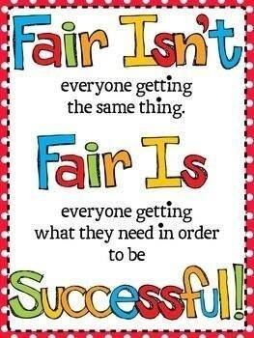
Notes:
This is displayed as the takeaway message from the community building activity.
From today onwards the next three days that is till the last days’ TLC , the best partners need to spend discussing about what is fair in education system? When ever they find time. They can also discuss on whats’ app/telegram.

Slide 6
Barriers to schooling and education
TYPES OF BARRIERS
Instructional differences
Social barriers
Cultural barriers
Infrastructural Barriers
Ambience: Noise, cleanliness,
Economic statuses
Physical/Biological
Intellectual differences
Emotional/Psychological
  low self-esteem,
  school violence and
  abusive behaviour
  LACK OF FOLLOWING FACILITIES : become barriers to some students
  Classrooms: space, equipment, visibility
  Seating facility, arrangement
  Manageable teacher – pupil ratio
  Well organised Multigrade class
  Teacher’s knowledge of Learning styles of students
  Adequate Learning pace of students
  Attendance and absenteeism
  Inefficient use of Teaching time
  Teacher efficiency
  libraries
  Teaching aids
  Print and displays
  Good laboratories,
  Availability of office staff, non-teaching staff
  Assembly and play/sports area
Notes:
To the Facilitator: Review of day-1: Barriers to schooling
Suggestion: Preferably insert a photo of the mind map generated on barriers to education on day-1
Facilitator while leaving the above slide or the indicator chart developed by the participants will ask the participants to recall what was done on the day 1, since morning. (collective activity. )
Tell the participants: yesterday we identified certain barriers to education. Of these which are the barriers that can completely push the learner out of the school. Recall the game we played just now. Participants are allowed three minutes to share their views.
Facilitator draw two columns on a blackboard/chart paper to make note of all those reasons which lead to school dropouts on a chart paper in one column. The other column is left blank to use for the next activity

Slide 7

EXCLUSION
Explicit and Implicit Bias
Concept 2: Barriers due to Exclusion: types and causes
Prejudice, Stereotypes, Discrimination
Notes:
Prerequisite knowledge for the facilitator:
Facilitator should know the kinds of biases, prejudices and stereotypes existing in Afghan society.
To be aware of the limitations of deficit model of integrative approach to education as against the inclusive model of education which accepts diversity to compliment learning styles
Awareness on which biases can be directly controlled and which can be addressed with interventions and corrective measures.
To be able to communicate to the participants that to address exclusion, planning before implementation is necessary. It should not be a trial-and-error process.
Addressing exclusion is a slow process as it involves creating awareness in all stakeholders in education about evaluation of ones own strongly held beliefs against evolving society and self-realisation .
Key competencies among others that helps realising our unconscious bias are empathy, belief in diversity as a resource, and diversity .
Objective of day 2: For facilitators: To communicate the message that
Barriers are a hindrance to inclusion.
Introduce the terms bias and exclusion
The dictionary meaning of Bias-Bias is a tendency to prefer one person or thing to another, and to favour that person or thing.
Exclusion is defined as ‘the process through which individuals or groups are wholly or partially excluded from full participation in the society
Exclusion is a type of barrier. Exclusion is either visible or invisible. They can be identified by noticing bias during verbal interactions, body language like facial and body expressions and in quality of need-based facilities provided.
Exclusion is either explicit or implicit and are deeply ingrained in the beliefs of individuals.
Implicit biases are often resorted to unconsciously. But recipient can feel that.
Some can be controlled , and others need interventions to address
Some barriers need time and can be got rid off gradually
Prejudices leads to stereotyping. Later it results in discrimination
While showing this slide, and the chart paper address the participants:
(point to the two columns on a blackboard/chart paper on which you (facilitator) had made a note of all those reasons which participants had shared their points / factors which lead to school dropouts on a chart paper in one column. The other column on the right which is blank we will use in this activity). while pointing the chart ), say “Look here. these are factors that prevent children from continuing education, and many of them are likely to dropout.
Now let us tick those which are biases. Bias means Can you think which of these biases will be easily evident and which are the ones not visible? How do we know such children are excluded and discriminated?
Facilitator to classify the factors as visible and non-visible while eliciting responses from the participants.
Facilitator will introduce the term EXCLUSION.
This way of imposing impossible criteria and keeping students away from attending the school is a form of exclusion
Facilitator’s Presentation and activity: “lets try to understand more about exclusion”
Introduction to Exclusion: (10 minutes)
Make a brief power point presentation: about exclusion (5 slides)

Slide 8
What is exclusion?
Exclusion is the outcome of multiple deprivations that prevent individuals or groups from participating fully in the economic, social and political life of the society in which they live.
In other words,
Exclusion is a treatment given to individuals or groups to wholly or partially remove them from full participation in the society
Notes:
Facilitator:
Ask the participants: Read what is exclusion. Do you agree? Are there any points left out? Is there any thing to be added to the above statement about exclusion.

Slide 9
According to UNESCO,
Exclusion is not that the children remain out-of-school.
Exclusion takes various forms in terms of the deprivation of their human rights and right to education and there by quality education.
Children deprived of basic shelter, security and safety
Poverty and inability to met the expenses which schools demand.
Absenteeism and irregular attendance
Learner needs are not met and absence of meaningful learning experience
Invalid certification
Deprivation from contributing learning for community and society
http://www.ibe.unesco.org/en/geqaf/annexes/technical-notes/exclusion-education-system
Notes:
Facilitator:
Ask the participants: Read what is exclusion. Do you agree? Are there any points left out? Is there any thing to be added to the above statement about exclusion.
For each point the facilitator need to give specific examples:
1: home less, street children, slum dwellers, child labour are some of the examples of exclusion from getting good health care and safety of children
2: though there might be a good school they are excluded because they cannot pay the fees, they cannot afford the kind of dress or books and stationery prescribed by the school.
3: Inability to attend school regularly either because of distance or due to domestic demand at home like taking care of siblings, not safe for girls to travel long distances, seasonal migration.
4: Examples: teaching and learning process not meeting the learning needs of the learner; teaching and learning process not corresponding to the learning styles of the learner; the language of instruction and learning materials is not comprehensible; learner goes through negative and discouraging experiences at school or in the programme, e.g. discrimination, prejudice, bullying, violence.
5. For example some certifications are not recognised and this will be a waste since such learning does not lead to any gainful job opportunity or are eligible for higher education.
6. Learning is of little value because of the low status accorded either to the organisation where they studied or the subject itself is considered of little value. As result it results in limited work opportunities that correspond to the area of learning acquired, or limited work opportunities in general; discrimination in society on the basis of socially ascribed differences that disregards any learning acquired by the person.

Slide 10
Hidden Exclusion
Hidden exclusion in education refers to providing access but not the required quality.
For example: Some private schools, and poorly managed public schools, provide free education but of poor quality .
For namesake children attend school but net gain in terms of learning would be poor in such schools.
Ref: https://resourcecentre.savethechildren.net/node/7312/pdf/ending_the_hidden_exclusion_executive_summary_0.pdf
Notes:
Facilitator: To ask participants to think of the possible reasons for poor quality of teaching and learning?
Possible reasons could be poor quality teachers, lack of resources, lack of toilets, … let participants list.

Slide 11
Types of Exclusion
Geographic Exclusion:
Economic Exclusion
Social Exclusion
Notes:
Facilitator: Provide examples of each of these types.
Geographic exclusion: remoteness, poor connectivity, difficult terrain, poor access to services, low agriculture or resource potential.
Economic exclusion: lack of access to labour market, lack of access to banking services
Social exclusion: Discrimination based on the basis of identity such as being man or woman, boy or girl, upper caste or lower caste, rich or poor. They suffer from multiple disadvantages. Ask the participants what could be those disadvantages especially for children.
Finally ask the participants what could be those disadvantages especially for children?
Open up for discussion and clarifications if any.
In the end tell the participants that : Till now we have heard about various problems that learners face and hence are deprived of education either due to barriers, biases, exclusion and so on. In the next 20 minutes form three groups and each group will get a theme and you need to plan and perform the role play. Some can direct the play, some can be dialogue writers, some can be actors and so on. One condition is every one in the team should contribute to some thing in the role paly.

Slide 12
Exclusion is a type of barrier. Exclusion is either visible or invisible. They can be identified by noticing bias during verbal interactions, body language like facial and body expressions and in quality of need-based facilities provided.
Thematic skit by participants.
Notes:
Facilitator: 30 minutes
Role play: three themes
Theme 1: To think of bias inside a classroom where a teacher is partial to students who score well and rewards them. The others never get a chance to receive reward even once. How they feel?
Theme 2: Parents: they have a twin children-one boy and one girl. Gender discrimination in the family
Theme 3: A school. There are one blind, one deaf, one slow learner, and polio child along with other students. The kind teacher is fair to all. Conduct an activity such a way that all children are happy and learn.
How to conduct the activity?
Tell the participants to form three groups: theme 1, theme 2, theme 3
Without revealing what topic each team gets, distribute the three topics to the teams. (Write the themes on three chits, fold them and distribute it randomly)
Tell them: ”this is a collaborative exercise. You decide the plot, number of actors, task distribution etc. plan a three minute long skit and present
While each team presents their skit, the other two will watch. In the end they one volunteer from each team gives feed back on the visible and invisible bias they could see.
Alternate Plan: Just in case the participants take more time to plan the skit, then tell the participants that after the short break the participants should present the role play

Slide 13

Bias is a tendency to prefer one person or thing to another, and to favour that person or thing.
Bias results in exclusion: Example: Believing that only gold fishes are normal have the right to be in water.
Notes:
Facilitator:
After the skit presentations are over, ask the participants to be seated and in conclusion display the slide 13
PPT to explain the concept of exclusion
Definition of BIAS and EXCLUSION
Bias-Bias is a tendency to prefer one person or thing to another, and to favour that person or thing. Bias could be based on gender, age, sexual orientation, gender identity, disability status, scholastic ability, and physical appearance such as height or weight.
Exclusion is defined as ‘the process through which individuals or groups are wholly or partially excluded from full participation in the society
Ask the participants: From our discussion and skit presentations can you think of biases which a teacher can have inside a classroom and indicators to identify them?

Slide 14
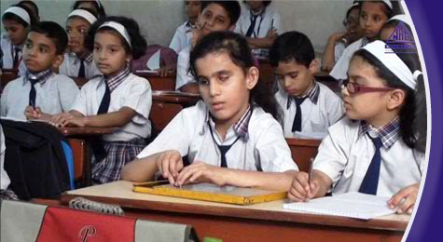
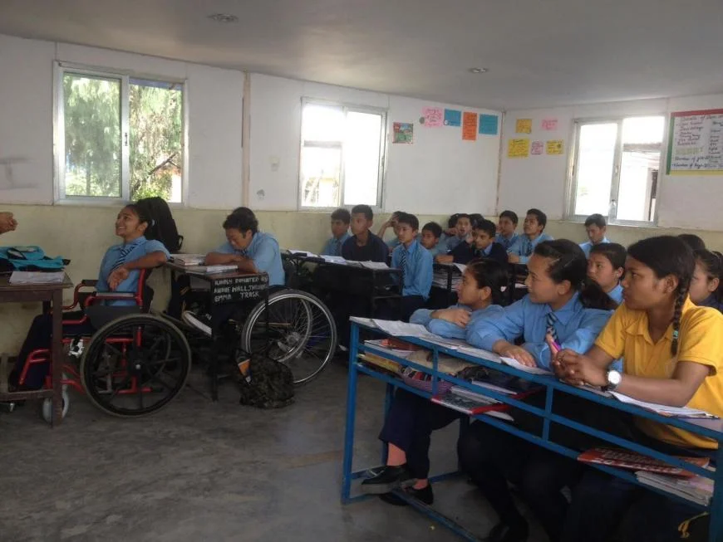
Notes:
Facilitator : picture reading: Invisible barriers
Suggestion: Prereading of the essay: What are some examples of implicit bias? – Mvorganizing.org
Activity: Reading the pictures:
Participants are asked to look at the two pictures in the slide. Keeping in mind the morning’s introductory activities, they need to think of all possible criteria that might ensue that, some of the students may remain outside the group?
Steps to conduct the activity: (Try to include the principles of UDL)
All of you look at the picture on screen. Observe all the details.
Make sure that all the participants can see the picture clearly. Those who want to have a closer look, you may come closer. (in fact, if the training venue has facilities for computers, some of the presentations can be shown on individual/shared computer, there can be opportunities to give feed back by messaging instantly and so on.)
Ask any two participants to volunteer to read the pictures aloud. “any two of you volunteer to read the picture. (either choose one man and one lady/choose one PPDM and one DPDM/ one senior and one junior member and so on) “. Tell them: “come closer to the screen,.
Expectation/ facilitate participants to look at the first picture on the left from the perspective of both physical diversity, safety factors and gender.
Add the participant’s observations to the chart paper when ever new observations are made.
Then move on to the next activity:
Objective: the next activity is exclusively focused on gender as a barrier to education in Afghanistan, being women as an exclusion

Slide 15
Diversity- being a boy or a girl
Do not include biological phenomena such as differences in anatomy and ability to bear children
Activities which only boys can do | Activities which only girls can do | Activities which both boys and girls can do
Notes:
Prerequisite knowledge for the facilitator: Facilitator should know the kinds of prejudices and stereotypes about men and women existing in Afghan society. They should also be aware of the statuses of several successful women both in Afghan society and in other parts of the world who have broken barriers of learning and means of livelihood.
Activity : “Gender Diversity-what it means to be a boy or a girl”, “Capabilities in learning and earning livelihood” : this is carried out in two parts.
Objective of this activity: to draw attention to prejudices and stereotypes in gender related issues and there by help participants reflect on its unconscious practices of discrimination
Activity part 1:
Facilitator/Trainer: For this activity, the facilitator shall divide the participants into three groups.
Quick grouping:
Wherever the participants are seated, they call out “only men”, “only women” and “either or men and women” (purpose: tendency is that familiar people are seated together. This is to shuffle them)
In their respective groups the members will list task which only men, only women and both can perform. After 3 minutes, the group leader lists the activities which are either entered in the table above or on a chart paper either by the facilitator or by group leaders
Facilitator/Trainer: Once all the entries are made, the facilitator reads out the list under each column and asks if there are any changes to be made. This is done for all three columns. Discussion about each activity listed under only men and only women is to get a common consensus that the classification if final. If it contradicts, then the groups to decide if that activity can be moved to both can do.
Outcome would be that most activities can be done by both with some ifs and buts. (Facilitators will tell the participants that we use this list to do the part 2 of this activity)
Alternate Suggestion: Get the participants to say in a sequence boy, girl, baby one after the other. Tell them that they form three groups: Men, Women. Either man/woman. All those who said boy will form men group, those who said girl will form women group and those who said baby will form either man/woman group. They should identify a leader for their group. Men and Women groups should list all activities which only men or women respectively can do in their groups . The third group ‘both’ to think of activities which both men and women can do. They write the activity on slips. Then the three-group leads will attach the slips on the wall/ write of a chart paper under respective columns designated for men, women and either man/woman

Slide 16
Activity 2: Why only Men? or Why only women?
Name the activity | Why do you say so
Notes:
Activity: Part 2:
Prerequisite knowledge for the facilitator: Facilitator should know the kinds of prejudices and stereotypes existing in Afghan society.
Outcome: This discussion will elicit the implicit prejudices and stereotypes
Caution: No body should take anyone’s words or opinions offensively. As soon as the activity is over, they should no longer treat themselves as opposition members. At the outset itself the facilitator must tell the participants that this is a fun game, and no one should take any opinion stated by their opposite partners in a defensive mode. Also, the opinion need not b specific to Afghan culture. It could be an international perspective. Facilitator should also indicate that the activity is purely meant as an exercise to learn to debate and negotiate, to
Objective of the activity: To help participants realise that the gender differentiation are socially ascribed and lead to discrimination. Being a man or woman is a natural diversity, like any other diversities among humans.
Take away message should be Men and Women are biologically different with specific needs, but this has nothing to do with gender neutral activities like schooling and higher education. Respecting each others’ differences and providing facilities to meet their needs is the spirit of inclusion.
Facilitator: After getting consensus for segregation of activities based on whether it is performed by either men or women or both, facilitator should choose six activities (three claiming only men, three claiming only women activities ) preferably pertaining to learning and education , the respective groups to give reasons or justify as to why they think that such an activity can be performed by only men/ only women ? The neutral group are free to challenge this assumption or can join any other group if they want to. The two groups should spend 10 minutes to prepare a debate. Then they seat opposite to each other and debate to justify their point of view. Irrespective of the outcome of the debate, the neutral group are given five minutes to justify why they consider some activities are gender neutral.
While the participants debate, the facilitators writes the words used by all three teams to make their point.
Facilitator should now pick up the words indicating prejudices, stereotypes and discrimination in the participants’ responses and use them as exemplars to explain the definitions for Stereotype, prejudice and discrimination. Facilitator should convey the message that most of the reasons listed are diversities which are socially ascribed, and hence acts as barriers to inclusion. Being a man or woman is natural, but justifying who and how one should be learning or get educated, where they should work are all socially ascribed. If we see the larger world, there are many women who have crossed these barriers and have proven time and again that educating women results in better economy of the family
Notes for facilitators: Definition of Terms: Prejudice, Stereotype and discrimination
A stereotype is an exaggerated belief, image or distorted truth about a person or group—a generalization that allows for little or no individual differences or social variation. Stereotypes are based on images in mass media, or reputations passed on by parents, peers and other members of society. Stereotypes can be positive or negative. Example: You are mathematics teacher’s son hence you must score cent percent, How can you run like boys?, You write neatly like girls, etc.
A prejudice is an opinion, prejudgment or attitude about a group or its individual members. A prejudice can be positive, but in our usage refers to a negative attitude. Prejudices are often accompanied by ignorance, fear or hatred. Prejudices are formed by a complex psychological process that begins with attachment to a close circle of acquaintances or an "in-group" such as a family. Prejudice is often aimed at "out-groups.“ He is a tribal boy so cannot speak english,
All our children are from rural background so they cannot perform in a choir,
Discrimination is behavior that treats people unequally because of their group memberships. Discriminatory behavior, ranging from slights to hate crimes, often begins with negative stereotypes and prejudices.
(Source of the definitions : https://www.learningforjustice.org/professional-development/test-yourself-for-hidden-bias )

Slide 17

What does a report say?
Girls in Afghanistan are significantly less likely to attend school than boys across all ages, but the gender gap widens from age 10 and peaks at age 14. This reflects increased barriers to education when girls reach adolescence. This brief looks at the profiles of out-of-school adolescent girls in Afghanistan, and the multiple barriers to education they face. They include socio-cultural barriers, poverty and financial barriers, school-level barriers, insecurity and conflict, and barriers to education for ethnic minorities.
In most countries, it is often a combination of factors which leads to exclusion from education. While this is also true in Afghanistan, it is particularly one single factor – being female – which presents a formidable barrier. Girls from poor households, in rural areas, and in parts of the country controlled by non-state actors are especially likely to be out-of-school. What is particular to Afghanistan is that there are also a high proportion of girls from wealthier households, in urban areas, and throughout all provinces who are out of school.
Source: https://www.unicef.org/rosa/reports/afghanistan-education-equity-profile-adolescent-girls
Notes:
Activity: part 3
Facilitator:
Prerequisite expectation from the facilitator or trainer: To know a few case studies of successful women who have achieved in terms of education in Afghanistan and in other countries abroad.
After the activity, flash this slide. Pause for a minute or two. Then ask any one of the participant to volunteer to read aloud from the slide.
After reading, pick up each underlined word or phrase indicating barriers and ask if the participants agree. Encourage them to provide specific examples of the barriers due to exclusion.
Facilitator : to read out from the slide and ask the participants the following three questions for reflection and note it their diaries?
Que 1: as professional development members what is their personal belief about education for all?
Que 2: what are the benefits of education of girls beyond primary level and encourage them to aim for higher education?
Que 3: Recollect and note down at least one example of a woman who has achieved because of education? ()
Repeat this message: Men and Women are biologically different with specific needs, but this has nothing to do with gender neutral activities like schooling and higher education. Respecting each others’ differences and providing facilities to meet their needs is the spirit of inclusion.
Further reading: https://www.unicef.org/rosa/media/5491/file/Afghanistan%20%E2%80%93%20Education%20Equity%20Profile%20for%20Adolescent%20Girls.pdf

Slide 18
Prejudices to Stereotyping to Discrimination
A child who does not fit in or adapt to formal school is abnormal: Prejudice
Rigid systems and practices in a formal school is considered normal
(Ab)normal children are labeled by schools: girl, disabled, special child, MR, migrant: Stereotyping
All these children are either deprived admission or put in special schools: Discrimination
Think ?
Should children adapt to school or
Should school accommodate children
Notes:
To Facilitator:

Slide 19
Variables and Diversities in formal learning:
 | 1
Economic class
Cultural
Language
Girl/Boy
Learning styles
Local/migrants
Health and nutrition
Learning opportunities at home
First generation
Notes:
Facilitator to discuss the examples of kind of diversity against each variable as an indicator of diversity among students. Let participants responses be recorded on this slide/ on a chart paper.
After this exercise ask despite these variable can we expect children to all fit into a school which expects uniform learning? Is it fair to group them as misfit? Ask them to think for a while on the possibility of providing what the child needs in the school instead of asking them to accommodate?

Slide 20
When the child is considered problematic (deficit model)
When the school is considered problematic
Child is labelled
Try to rectify impairments
Assess and segregate the child
Focus on making then ‘normal’
Aim : main-stream/drop off
Rigid classroom protocol
All to learn in same way
Common teaching methodology
Teacher belief: some need special school
Diversity rejected as a block to functioning
Results in formal schools
Child ‘s needs valued
Alter expectations
Rectify barriers, accommodate
Focus is built on the strengths
Aim : responsible citizens
Adaptive classroom protocol
Vary according to learning styles
Teaching methodology vary
Teacher belief: Every child can learn
Diversity welcomed as a resource
Results in inclusive schools
Notes:
Facilitator led: Requires detailed explanation from the facilitator. The session can be made interactive by asking open ended questions
Objective:
To present the differences in the premise with which formal and inclusive schools try to provide education.
Show how diversity is treated .
Explanation:
A formal school views any deviation in a child’s learning styles to be problematic. These schools claims to teach normal children usually do not admit differently abled children. In fact, they prefer uniformity to such an extent, they shy away from encouraging multi-grade classrooms. As a result ,formal school look at differences in children to be problematic. (go through the 11 points on the left hand, side.) Explain each phrase with an example.
The child’s physical or cognitive differences are highlighted, or they simply attach a tag special child/ differently abled child, deaf, blind, and so on.
The school tries to even out the differences ‘ in the differently abled by providing some aids. For example, even while introducing these children are identified with the deficiency if any.
The type of diversity is identified and are separated from main group. Teachers in such schools strongly believe in uniform learning. Though it is proven scientifically about multiple intelligences, in practice all children are expected to learn through a common method taught by the teachers. The effect of this on the child varies. The extent of deviation from the normal is assessed and evaluated.
The schools try to bring them to mainstream if these students’ competencies are comparable and match the ‘normal’ students.
In case if the difference in terms of diversity cannot be removed, such children drop out of the mainstream school.
The pedagogy in formal classes follows a ‘one-size fits all’ model.
Every child in a class is assumed to learn the same way and this is taken as a standard measure to measure their learning and the school decides the kind of treatment needed. Students are indeed seen as patients requiring medical intervention to make them normal.
Even if such students are physically present in the same classroom, they are merely integrated and they do not get any opportunity to participate in any pedagogical activity.
On the other hand the difficulties and discrimination faced by children to learn in a uniform manner when seen from the point of view of deficiency in the system, they try to accommodate all children. The teachers in such schools believe that every child can learn so that they can be educated enough to become responsible citizens.

Slide 21
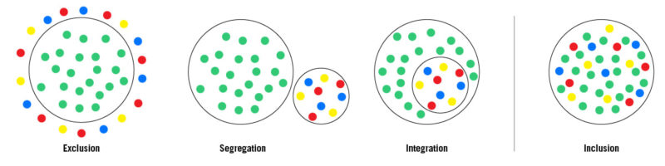
Notes:
Important note to facilitator: This session will have three kinds of activities. They are understanding the meaning of Inclusion, discussion about an Inclusive Literacy Classroom followed by a paired activity to imagine an inclusive literacy classroom by distinguishing it from a formal classroom – an imaginary real-life case.
This session is very important preparation for day-3 training concept called the Universal Design for Learning
Facilitator: To ask the participants: “Observe the pictures and think of what it communicates about the situation inside a classroom? The circle represents school and coloured dots represent different children with different styles of learning”
Objective:
Formal schools promote exclusion, segregation or mere integration
But even integration is not inclusion.

Slide 22
Inclusive literacy Classroom
Visual directions:
Activity-based instructions for the whole class that combine words and pictures.
Individualized visual directions for specific activities
Individual visual supports that help students navigate the structure of (classroom)
Reference: https://jillianstarrteaching.com/inclusive-literacy-centers/
Notes:
Next introduce the possibility of inclusive literacy in classroom.: (5-10 min)
Activity: This is a facilitator led discussion on inclusive literacy in the form of question and answer.
Seating: preferably in a circle along with the facilitator.
Prerequisite knowledge for the facilitator:
Fair knowledge of inclusivity, inclusive pedagogy, inclusive classrooms from across the world- both from developed and developing countries , resource rich classrooms, Multi-grade classrooms, UDL classrooms.
The following article provides some insights into how one of the inclusive literacy classroom looks like. Prereading of this before the training is recommended: https://jillianstarrteaching.com/inclusive-literacy-centers/
Initially the Facilitator begins the discussion with a series of questions. They will also answer if the participants do not respond. Facilitators should ensure to encourage participants to ask questions
Facilitator:
What is an inclusive literacy classroom? – It supports students without singling them out and ensuring they feel empowered (and powerful) in the classroom.
Which learners feel empowered in such classroom? Give example? – Every student feels empowered in such a classroom. It is especially empowering for students who have a different home language, or dialect, for those who are new to the medium of instruction used in school. Example a child who knows only Pashto but admitted to an english medium school.
What do teachers think while planning in an inclusive literacy classroom? - inclusive literacy classroom is centered around the aim to support each and every child to learn meaningfully. So such teachers ask the following two questions: “Is my resource or lesson scaffolded in a way that supports ALL of the kids in my room?” and “How can I modify, challenge, and extend my content for those who need it/are ready?”.( https://jillianstarrteaching.com/inclusive-literacy-centers/)
If the teacher has to cater to each learner, how many ways of individualized and inclusive support can be provided? Is it really possible for a single teacher to do this? – There are multiple ways of individualized and inclusive support which a teacher can learn. Such teachers draw support from other stakeholders like the parents, community members, school heads, colleagues, PDMs, education department, NGOs and so on who are also are preferably informed about the possibility of inclusion in school and in particular the possibility of an inclusive literacy classroom.
What are the characteristic features of an inclusive literacy classroom?- There are many. One most important aspect of a functional classroom is the learners are clear about ground rules, they have clarity on their tasks, they can be independent with most of the task, the classroom is prepared with resources which are freely accessible to students and the class is normalized, calm and absence of chaos is evident. In such classroom every individual will be working at their own pace. The teacher makes sure that multiple scaffolds are available and presents them to students as per the learner’s needs. One strategy for example a teacher found the oral instructions worked fine for only a few. Others needed repeated reminders. So along with oral instructions, lot of visual instructions were added. Since every student by nature desire to be independent, they visual instructions made them to rely more on visual cues and their peers rather than only on the teacher. It gave them a feeling of being independent and empowered.
What is this type of teaching called? -Inclusive pedagogy
In the end tell the participants that this is just a sample., and others also continue to ask questions or share their answers. The questions can be noted in the personal diary and answers can be found out from various sources. These should be preferably posted on what’s app / telegram groups to gather more knowledge and ideas.
Lastly tell the participants that they will work in pairs to think of an inclusive literacy classroom. Participants are free to choose their pairs for this 10 minute long session
Materials required: Facilitator suggests participants to read online or provide a few hard copies of the reading material.

Slide 23
A case of Rafiq and Reshma. They are 12yr and 6yr old respectively. They have never been to school earlier. They can speak Poshto. They have no idea of either Daari or English. Or for that matter they do not know any other language. What would be their experience in formal classroom and inclusive classroom
Formal classroom | Inclusive classroom
I
Notes:
Objective: To get a glimpse of an inclusive classroom.
Paired activity:
To think what the children might experience in a formal classroom and in an inclusive classroom, and fill the table
Facilitator: Displays slide 23 and reads out aloud the case of Rafiq and Reshma. Then tell the participants: You take 5 minutes to work in pairs and think of all that you can do to scaffold the two children so that they feel empowered and independent in the new school.
In the case of Rafiq and Reshma, list out all possible strategies the school can do to help the children?
In the end each pair shares the strategies they thought of on a paper, reads them aloud taking turns and fixes it on to the chart paper or common display board.
Facilitator fills out the blank cells to make a consolidated table in the slide 23.

Slide 24
Inclusive school indicators →barriers ↓variable/diversity | Social | cultural | Institutional | Emotional and cognitive | Physical and cognitive | instructional | economic | gender | infrastructure
girls | Awareness drive in community | Allow students to wear which ever dress code accepted | Appoint women teachers | Attendance not rigid |  | Teacher instruction is bias free | Freeship/scholarship | Avoid unconscious discrimination: text book oictures | Separate washrooms
boys
Physical disability
Intellectual diversity
Displaced/immigrants
Teachers
Learning resources
Notes:
Facilitator:
Instruct the participants to think of all possible indicators of clues that help them identify the inclusive practices. (Below is just a sample of how you as a facilitator can get the participants to begin to think about indicators )
In this activity the participants will think of the strategies used to address the barrier against the variables or diversity in school
Example of how to explain the table: The horizontal rows list the barriers to schooling which you identified on day one. On the left column the type of diversity in a student is listed. Against each diversity and the barrier, think of what could be the indicator of inclusivity to address the barrier with respect to the diversity.
For example first row is filled as sample.
The participants will work in small groups of three or four and try to fill the table and present at the end of the task

Slide 25
https://www.unicef.org/afghanistan/stories/learning-today-inspiring-tomorrow
Download the above hard copy of the article or read online
Notes:
Facilitator: https://www.unicef.org/afghanistan/stories/learning-today-inspiring-tomorrow
Preparation: either original english version or the translated version is used. A hard copy or soft copy is provided to all the participants before the session begins.
Instruction:
Facilitator will instruct the participants: “this is a reading activity. Reading can be done in three ways of their choice:
Read silently all alone and make notes. Prepare in such a way that you can narrate this story to all.
You can read in pairs : Two of can read together, silently/ share reading. Later you discuss the case study keeping in mind the last two days learning from the training.
You can even read collectively- say a group of five. One person will read aloud. And others listen. They summarize orally, followed by critical discussion.
This story is later on used as the lead for TLC discussion. Based on day 1 discussion or barriers, day 2 discussion on inclusion, participants should discuss Royeda’s case, what were her circumstances to achieve, how she negotiated, gender issues in her family, support she received from her husband and so on. Can teachers like Royeda be increased in the community so that the shortage of women teachers can be improved?
Finally the participants enter in the interactive diary what is their learning and belief about the possibility of sustaining inclusive school

Slide 26
Structured Reflection session
How | Why/What/Which/When | So What
Positive emotion | What went well for you? Feedback for the facilitator’s presentation
involvement | Which activity gave you insights? Which activity kept you engaged? Which aspect were difficult/easy?
Peer relationships | What was your experience in communicating? With facilitator/coparticipants
Understanding | What were your expectations for the day? What do you want to share or get clarification from the facilitator? What more are you expecting from tomorrow?
Achievement/ Accomplisment | Why are you satisfied/not satisfied? What is your take away?
Notes:
To Facilitator:
Every day ends with structured reflection of the day.
Objective:
This is to simulate the TLCs facilitated by trainers. For this all participants are required to sit in a circle along with the facilitator.
Materials: (If needed the ppt slide can be displayed)
Participants must have their pens, interactive diaries and their personal notes.
In the interactive diaries they need write to the facilitator as a feed back, seek clarification, share their points of view.
In the end the facilitator will collect their diaries and respond in writing to each one of them and return it the next day morning.
In the personal diaries the participants make notes from the discussion they carry out on the topic,
It is recommended that the Facilitator makes note of intangible feedback from participants various feelings such as happiness, disappointment etc. and use them as examples to draw their attention towards implications of barriers.
The following are some of the questions which can be kept on as a slide to facilitate the structured reflection session:

Slide 27
Conclusion:
Thinking (self and is intangible):
Creative and Innovative thinking, System and strategic thinking.
Management: (both self and others. Partly visible as absence of chaos and confusion): Self-awareness, Social awareness
Exhibited skills: Active listening, Speaking : logical and critical communication, analytical skills, negotiation skills

