Slide 1



Module : Inclusive Schools
Introduction
Notes:
Module : Inclusive Schools
Overall aims and desirable prerequisites and outcomes
(In this module in the ppts and the facilitator guide the information and pictures accessed from internet are exclusively used for educational purposes and as representation and no copyright infringement is intended)
This module expects the participants and trainer to either already have or develop certain competencies to realise the aims of sustaining inclusive schools
Competencies required Trainer of Trainer (MTOT)/Master Trainer/Facilitator
Competencies to be developed in PPDM and DPDM
Beneficiaries:
This is the training for provincial professional development members (PPDM) and the district professional development members(DPDM).
Requirements
Prosed to make the module inclusive and participants are offered experiential learning about the philosophy of inclusivity
To bring in inclusivity right from day one of the training, it is desirable that on day one a whats app /telegram group of all participants along with the facilitators and organisers are created. This will introduce them to comfort and transparency that can be brought in communication.
This e-group can also be used to make announcements, gather information, making collective decisions, make clarifications, to brainstorm, debate and discuss on various concepts etc.
Note: Trainer of Trainer (MTOT)/ master trainers/ Facilitators (these terms have been used interchangeably but consistently mean the same) are drawn from pool of resource personnel serving as central professional development members (CPDM) and provincial professional development members (PPDM) or any other expert educationist: These are the new designations to the members in Professional Development Directorate. Earlier they were designated as Academic Supervisors at the central, provincial and district levels with specific roles and responsibilities.
Expectation from the master trainer of trainer/facilitator to conduct workshop for the Module: Inclusive Schools
General desirable prerequisites for the trainers before conducting this training:
Awareness of the education sector plan, Afghanistan.
Awareness of the competencies to be honed and subject them to continuous development at all levels.
Practice the principles of inclusion in their day-to-day work and demonstrate it during the workshops.
Have gone through the other modules with deeper understanding of the modules on pedagogy.
Are convinced that all individuals have different abilities and styles of learning and hence there are diversities among learners.
Believe that diversity is a natural phenomenon, inclusion is a response to diversity.
Aware that most of the barriers to inclusion at both intra and international situations are due to exclusion and biases.
Be convinced that the barriers can be mitigated or minimized in an incremental manner by simultaneously using both top down and bottom-up approaches.
Knowledge of Universal Design for Learning (UDL) to promote inclusion.
Be able to communicate the aspirations of MOE and the strategies of UDL to enthuse and motivate to the participants (DPDM and PPDM) in such a way that they in turn gradually overtime become competent enough to contribute to the implementation at the grassroot levels.
Conduct activities and presentation to achieve the learning objectives of the participants.
Skills of generating mind-maps/ concept maps with the participants in an interactive manner.
Enable the participants to develop/use a checklist to identify and record the diversity acting as barrier to inclusion at the school level, develop the competency to facilitate TLC for skill transfer at the intra and interschool levels, facilitate schools towards sourcing and collecting resources for creating UDL classrooms, and develop the expertise of reporting the ground level situation to PPDMs.
In addition to the above the Master trainers will enable the PPDMs to engage in consolidation of the reports from district level and provide resources for cross learning and skill transfer across the districts.
Providing constructive feedback and guidance to the participants in the interactive diaries- a quality essential at all levels between the facilitator and the learner.
Materials to be kept ready for the four-day training:
General for all the days: ppt, markers, sketch pens, chart paper, chalk/colour powder for marking on the floor, interactive handouts (like worksheets) for participants, notebooks/plain sheets/folders, appropriate adhesives/thread to display the work, seating plans (mats/chairs/desks),
On Specific days:
Day 1: bangles(all same medium sized), a ball, a bell, chalk/ colour powder
Day 2: paper slips, pencil, chart paper, ppt , pins, glue tac, adhesive tapes,
Day 3:
Day 4:bucket, paper balls,

Slide 2
Welcome activity:
1: Greeting and setting ground rules (common for all modules)
2: Community building activity-1
  “One size does not fit for all”
  “Need for tailor-made or customized opportunity”
Notes:
Objective of welcome activity:
Community building exercise: Get participants to know each other.
Take away message: Importance of need based flexible support : “One size does not fit for all”, “Need for tailor-made or customized opportunity”
Note to facilitators /Trainer: Instructions to perform welcome and community building activity
Get all participants to settle. Set clear expectations on nature of participation and announce the non-negotiable ground rules to be adhered to. (These rules will preferably be common across all the days of training and across all the modules to ensure discipline, give clarity, to avoid chaos and for time management).
Greet the participants as per the protocol. Get them to fill out the GDAS competency form.
This ice breaker activity-’bangle activity’ (can be done as an indoor or outdoor activity depending as per convenience) is aimed to help the participants experience exclusion. (materials needed: medium sized bangles (alternately you many use finger rings, gloves, hoops, hair bands, paper rings etc ) all same size enough to give one each for each participant, chalk to draw two concentric circles on the floor, one A3 sized chart paper and marker, adhesive or thread/nail to hang the chart paper). This activity has two parts.
PART-1 of the bangle activity
Draw two large concentric circles on the floor such that the space inside innermost circle can hold about 20 people, about 30 participants in the space between the inner and outer most circle and about 40 people around the outermost circle. Ask all participants (PDC member) to keep their hands free and gather around the outer circumference of outer most circle. (preferably drawn even before the participants arrive to the venue, and if possible, should be retained all through since they come handy for collective activities)
Let them starting calling out from #1 and each adjacent person calls out the next consecutive number aloud. Finally, the last number which is equal to the total number of participants in the activity to be marked as total number on the chart/blackboard
Later ask them to turn to the neighbour such that they are in pairs facing each other. Next tell them that each pair are ‘best-partners’.
Next instruct them to greet and introduce each other with two information. One their full names and another how they wish the world to recognize them as (the identity they wish to have). Also tell the participants that they need to remember their best-partner’s name and identity at least until the next day.
Now tell them that you will begin the next activity. Explain the activity as follows: “here is a school enrolment drive, a lifetime opportunity to get admitted to the best of best schools with the best facilities irrespective of their differences. The selection procedure is very simple with just one criteria to be satisfied. If the candidates fulfill that, then they get admitted.
Here are two circles with a gap in between.
As you see, all of you are standing on the outside of outermost circle.
At the end of the task, those who are occupying the space outermost the circle form group ten as they get 10 points, those found in-between the two circles form group one and they get one point and those in innermost circle form group zero and they get zero point.
Tell the participants, “Now you will get one bangle each. Just pick it up and wait till I say what you need to do. (So, saying, distribute one bangle each to each participant.)
Ask, “Did you all get one bangle?”, Try to insert it through your left /right hand. “Pass it through your hand so that it is around your wrist. You get 2 minutes”.
At the end of two minutes, draw their attention towards you and ask them to do the next action. Give instructio“All of you whose bangles reached the wrist can enter the innermost circle, for those whose bangles just entered halfway of the palm say up to knuckles will enter the outer circle and stand in the space between inner and outer circles. If the bangle did not enter the hand, then they will remain where they are on the outside of outer circle.
After the participants are distributed in different circles and settle, Now explain : The innermost circle represents the school with all facilities and admits those who fit into their stipulations. If the ring/bangle easily passes through their hand, then enter the innermost circle, The second situation represents schools with little or no resources and hence they have flexible criteria that, even if the bangle reached half-way they may enter the space between inner and outer circle. In the last case, if the bangle does not pass at all there is no entry into any school, and they stand where they are outside the outermost circle
In the end count the number of participants in the different zones-group 10, group 1 and group 0 from the outermost to innermost regions of the circles and mark it on the chart. (Note: This activity is performed while all teachers are standing in a circle/ seated on chairs (similar to musical chair activity)
Give each one a piece of plain white paper approximately the postcard size or 4” by 6” and a pin. Ask the participants to write the group to which they belong to and attach it to their dress near left or right shoulder.
PART-2 of the bangle activity
Facilitator to instruct all the participants to remain in the three groups – 0,1, and 10 when they return to their seats. Once the participants settle, continue the activity
Make sure that the participants must remain in their new groups 0,1 and 10 with labelled slips attached to their dress and return to their seats.
Begin by asking “How many of you do not have your best partner in the same group as you are in? Please raise your hands” . (irrespective of the numbers, there will be some who are separated). How does this feel? How else would you have preferred to play this game?
Tell them “now let us reflect for a few minutes on this activity” and ask, “even though the criteria for entering innermost circle was same for all, all got equal opportunity, time and even bangles, but still why did it not provide equal results for all?”- (Their answers would probably convey that the bangles were either too small or that everyone’s hands are not of equal size. If not direct them to think in terms of the bangle)
How would they feel if the same condition was ”only those who are in the inner circle will get increment in their salary?”. Let them discuss for two minutes in their groups and select one member from each group to volunteer and answer.
Next engage in discussion with questions:
Did this activity remind you of any personal experience when you were refused privileges in real life situation for not satisfying certain criteria?
Have you come across real cases of such a discrimination in terms of gaining admission to schools?
(Keep probing to brainstorm as to) Why is it so that students do not have equal access despite common rules and claims of equality for schooling?
Let a few participants share until the message that equal entry conditions does not necessarily ensure admission to desired school. Note the responses until a few barriers to access to school are elicited.
Finally ask “just like the same size bangles did not fit each hand, how the situation would have been if there were different sized bangles?, and how it would have been if the participants had an opportunity to choose the size that fits them.”
Facilitator can draw comparison of bangle to common rigid curriculum which leads to isolation like the way many did not enter inner most circle. The group number and scores are irrational but can leave deep scars. In this game how your best partners were separated. Attaching to some group and asking the students to remain there is also demoralizing. If multiple sized bangles were provided and opportunity to choose, probably each one of you could have entered innermost circle. This is called ‘tailor-made or customized opportunity’, since ‘one size does not fit for all’.
Conclude the activity by announcing that each participant, “during short break, write a word, phrase or a sentence, poem, or draw to show how you felt and what went on in your minds? when the bangle fitted /did not fit your hands”.
Facilitator: takes over to explain: Like fixed criteria set in the game, similar such eligibility criteria are set in the society that prevents all students gain access to schools. These are the barriers. But MOE in Afghanistan aspires to remove barriers and make flexible eligibility criteria. Let us understand what they are. (flash the next slide : Aspirations of MOE)

Slide 3
Aspirations of MOE: Afghanistan
Creation of a school and classroom environment that is safe (physically and psychologically), healthy, non-discriminatory, inclusive and child friendly
(p:5, https://www.globalpartnership.org/sites/default/files/education-sector-plan-afghnistan-2017-2021.pdf)
Equitable Access to Educational Opportunities Demand Side Strategies:
  Some of the key demand side barriers are poverty, social norms and practices (early marriages) and
  these are exacerbated by supply related issues such as lack of schools within walking distance, lack of female teachers, etc.
Increased equitable and inclusive access to relevant, safe, and quality learning opportunities for children, youth and adults in Afghanistan, especially women and girls.
To facilitate equitable access, linking both supply and demand will be critical to ensuring children complete basic education and learners in general make full use of learning opportunities.
Community participation and commitment is a key strategy and sustained community participation will be encouraged and monitored.
(p:6, https://www.globalpartnership.org/sites/default/files/education-sector-plan-afghnistan-2017-2021.pdf)
Notes:
For Facilitators/MTOTs: 10 minutes
Allow a minute to go through the slide.
Ask if any participant to (one to three) volunteer to read aloud. Pause after each sentence to stress on the key points, elicit questions and clarify what it means to the participants if required.)
Briefly draw the participant’s attention towards inclusion of all individuals and equitable access to schools which are inclusive, relevant and safe as aspired by MOE. You might even ask them to make a note of this in their handouts/notes that these are the aspirations of MOE and as professional development members they need to strive to help schools to meet these aspirations
“Increased equitable and inclusive access to relevant, safe, and quality learning opportunities for children, youth, and adults in Afghanistan, especially women and girls. Increased equitable availability of responsive, safe and conducive learning and skills training opportunities”.
Next tell the participants: Lets see what we will be doing during this four-day workshop. So, saying, spend next 10 minutes with the following four slides: title slide (a few seconds), Overview of four-day training (2 minutes), Desirable learning outcomes (5-6 minutes), day 1 timetable (1 minute)

Slide 4
Overview of the four-day training on Inclusive schools
Day | Sub-Topic | Concepts
1 | Barriers to Inclusion in School and issues of child protection and Gender | Challenges to achieve academic, emotional and social success of all children.
2 | Exclusion in School: gender and child protection issues | Barriers due to Exclusion: explicit and implicit Biases Prejudice, Stereotypes, Discrimination
3 | Universal Design for Learning | UDL and Inclusive pedagogy Diversity facilitates inclusivity
4 | Vision building: Sustaining inclusivity and role of Professional Development Members in promoting inclusive schools | Equality of access- Difference between integration and inclusion
Notes:
Trainers will spend two to five minutes to walk through the participants about the four day’s workshop

Slide 5
Desirable learning outcome from the 4-day workshop
Knowledge of barriers to inclusion and identifying them
Knowledge of Universal Design in learning
Knowledge of Inclusive Pedagogy and ability to recognize them.
Understand the concept of Inclusion
Develop a vision for building inclusive schools and the role of PDMs in sustaining inclusive practices.
Provincial Professional Development Members
District Professional Development members
Collate the data on inclusion gathered from DPDMs.
Prepare consolidated critical reports from different districts on inclusive practices and their strengths and weaknesses, and present them to CPDM or the PDD
Mentor the DPDM to support teachers at the school level
Be a link between DPDM and CPDM for to ensure need-based support from PDD to respective Districts.
Visit schools, Observe, Identify and record barriers to inclusion in schools and community.
Be able to recognize and document inclusive practices in schools using check lists and forms.
Facilitate TLC for cross learning and skill transfer across managements, schools and teachers
Be a link between PPDM and School head and teachers to ensure need-based support from PDD to reach classrooms.
Notes:
Note to Facilitator: (5-6 minutes)
Objective is to help participants understand what are the desirable learning outcome in the participants after participating in the four-day workshop:
Clearly explain the commonalities and differences in the roles of PPDM and DPDM.
In order to make it interactive, even before showing the slide, the trainer can ask what do they think that they might learn in this workshop, get three to four responses and quickly move on to present the notes in this slide.

Slide 6
Inclusive Schools
Day 1: Barriers to schooling
Notes:
Facilitator’s Objective for Day 1: Barriers to schooling
Develop an understanding of the complexity of different barriers to education.(Mind-map will provide visual stimulus to the complexity)
Help participants reflect on the challenges to achieve academic, emotional and social success of all children because of the barriers.
Using a check-list to observe and recording barriers to schooling and developing awareness of sorting the issues concerning barriers in terms of the levels at which it can be addressed.
Prerequisite knowledge/skills for Facilitator:
1. Familiar with different barriers to schooling in Afghan and in other developed and developing countries
2. Knowledge of various interventions, their strategies and outcomes to promote inclusivity in Afghanistan
3. Communicate to the participants that the barriers can be controlled or minimized at various levels.
4. Help participants understand to segregate the issues of inclusion as ones which they can themselves address and the ones to be addressed at the central level .
5. Enable the participants to understand how to document ground level issues and report to higher levels
6. Knowledgeable about mind-maps. (For this module, to generate a mind-map during the workshop in an interactive mode while eliciting the barriers to education from the participants.
Recommended literature for facilitators for prereading for Inclusive Schools module:
https://www.learningforjustice.org/professional-development/test-yourself-for-hidden-bias
https://www.unicef.org/rosa/media/5491/file/Afghanistan%20%E2%80%93%20Education%20Equity%20Profile%20for%20Adolescent%20Girls.pdf
INCLUSIVE EDUCATION, TRAINING of TRAINERS MANUAL, Steps towards Afghan Girls’ Educational Success II, Aga Khan Foundation, Afghanistan, April 2018
https://www.unicef.org/education/inclusive-education Inclusive education | UNICEF
https://www.globalpartnership.org/sites/default/files/education-sector-plan-afghnistan-2017-2021.pdf
https://www.concernusa.org/story/barriers-to-education-around-the-world/
https://www.concernusa.org/story/girls-education-in-afghanistan/
https://www.eenet.org.uk/resources/docs/Inclusion%20in%20Action%20METHODOLOGY.pdf
https://www.unicef.org/education
https://www.globalpartnership.org/where-we-work/Afghanistan
https://www.unicef.org/reports/UNICEF-education-strategy-2019-2030
www.teachingtolerance.org
https://www.cast.org/impact/universal-design-for-learning-udl
CAST: About Universal Design for Learning
https://www.texthelp.com/resources/universal-design-for-learning/
https://www.unicef.org/afghanistan/stories/learning-today-inspiring-tomorrow (must keep a soft or hard copy ready for day two reading session)
17. Online blog by Morin, A. (2018). Universal Design for Learning (UDL): What You Need to Know.
18. Additional reading by Ralabate, P. K. (2011). Universal Design for Learning: Meeting the Needs of All Students. The ASHA Leader.
19. Document by Booth, T., & Ainscow, M. (2002). Index for Inclusion- Developing learning and participation in schools. Centre for Studies on Inclusive Education. [Note: read pp 13-37
20. Reference: N for nose: state of the education report for India 2019; children with disabilities - UNESCO Digital Library P(75)
For the facilitator: 10 minutes
Address the participants and tell them that you will be sharing about what they will do in the next and the following three days.
Present the next three slides which is an introduction to overall plan for next four days sessions for setting expectations.
The facilitator makes a ppt presentation of the following three points:
Overview of the workshop in the next four days
Desirable learning outcome in the participants from the four-day workshop: Clearly explain the commonalities and differences in the roles of PPDM and DPDM.
Quick walk through the timetable for Day-1

Slide 7
Notes:
To Facilitator: Finally flash this slide and conclude saying: In the next four days including today, we engage in understanding how these aspirations of MOE can be realised by establishing and supporting inclusive schools. (Instruct them that session continues after a ten-minute short break. Remind them about the chart paper in which they need to write or draw how they felt during bangles activity especially when they were isolated or separated from their best partners)
Tell the participants that all four days will have the same format. It will be day long workshops, 7 hours or 420 minutes. Out of this one-hour lunch break and 10 minutes each there will be two short breaks of ten minute each. One short break before lunch and the other after lunch break.
Morning the session begins with a general/thematic community building exercise followed by introductory or recap of previous day’s activity.
The day ends with structured reflection of the day. This is to simulate the TLCs facilitated by trainers. For this all participants are required to sit in a circle along with the facilitator. They must have their interactive diaries and their personal notes.
In the interactive diaries they may write to the facilitator. In the end the facilitator will collect their diaries and respond in writing to each one of them and return it the next day morning.
In the personal diaries the participants make notes from the discussion they carry out on the topic,
It is recommended that the Facilitator makes note of intangible feedback from participants various feelings such as happiness, disappointment etc. and use them as examples to draw their attention towards implications of barriers.
The following are some of the questions which can be kept on as a slide to facilitate the structured reflection session:

Slide 8
Day 1 Diversity as a barrier to inclusion
Concept 1: Barriers due to diversity
Objectives of Day 1:
Brainstorm all possible barriers to inclusion
Identifying the barriers in real situation
Using checklist to record barriers
To discuss possible solutions to get rid off barriers
Expected take away: Participants get a glimpse of the vast barriers to access to schooling.
Notes:
Prerequisite for the facilitator: Informed about the kinds of barriers and evidences of barriers from national and international scenario. Knowledge of developing a mind-map.
Materials: Blackboard/ preferably chart paper with a few colored markers, ppt presentation, handouts/worksheets,
The trainer of trainer /facilitator :
1. Collective presentation: Make a brief PPT presentation to create a context to help the participants to recall the barriers in the school and community (3 minutes)
2. Small group activity: Make small groups of five each and facilitate discussion in small groups to ensure that the different types of barriers are brainstormed. Participants should be encouraged to note down the list of barriers in their worksheets.
3. Collective: Volunteers from group share their list of barriers, the facilitator makes a consolidated mind-map on a chart paper
How to conduct this session:
Step 1: (3 minutes) Recall the bangle activity. (Point to one or two statements or pictures on the chart paper used during bangle activity that shows disappointment).
Ask : How would it have been possible for all others to also enter the innermost circle ?
Ask: What was preventing everyone to enter innermost circle? Answer: Size of the bangle : Tell the participants that in this activity size, relying on only one size was the barrier for many. Similarly ask them to keep thinking of the reasons as to why many children do not enroll, or drop out in between, discontinue or even if they are in school lag in studies despite the availability of schools and school curriculum. (Probe to elicit responses indicating inaccessibility)
Step 2: (5 minutes): Begin PPT presentation of pictures. Ask the participants to observe each picture and think of inaccessibility in each case- Example: nature of inaccessibility, which children? what prevents some children from attending such schools? Pause in each slide and elicit at least 2-3 responses.
Step 3:

Slide 9

Education can help to end poverty. Conversely, a lack of education has a disastrous effect for individuals, as well as their communities and countries.
This is why a universal primary education is one of the UN’s Sustainable Development Goals for the year 2030.
Many of the poorest countries in the world are also those that have the poorest education rates.
In 39 out of 99 countries, fewer than 50% of the poorest children have completed primary school.
In Afghanistan, fewer than 1% get this crucial basic education.
Reference : https://www.concernusa.org/story/barriers-to-education-around-the-world/
Notes:
To Facilitators:
In order to set the context, to think of barriers, spend less than a minute to draw the participant’s attention to the universal truth of the importance of education to alleviate poverty. Draw their attention to the UNESCO report about 99% not getting the crucial basic education. Then tell them that the next few slides will help them think of the reasons as to why most of the Afghans are not getting basic education ?

Slide 10
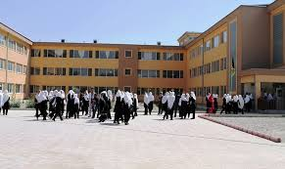
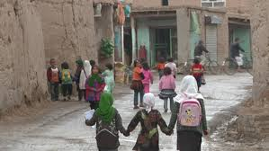
What comes to your mind in terms of access to schools?
Photos: Google images
Notes:
Facilitator: to facilitate the participants to critically comment on the diversity in access to schools
Diversity in terms of availability
Tell the participants and comment on possible barriers to get education: Possible answers: school building-extreme difference: rich vs poor, urban vs rural, distance and access, transportation and so on.

Slide 11
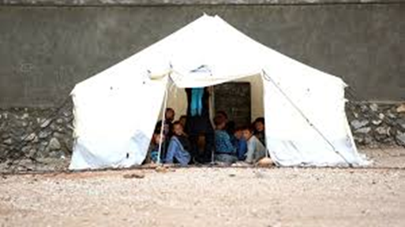
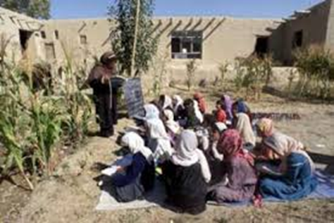
What are various barriers if any in these schools?
Photos: Google images
Notes:
Suggestion: Facilitator should ask questions to elicit: circumstances in which such schools have been created? What are various barriers if any in these schools?

Slide 12
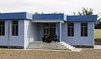
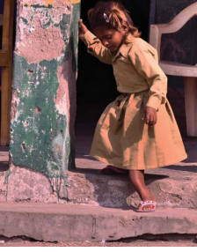
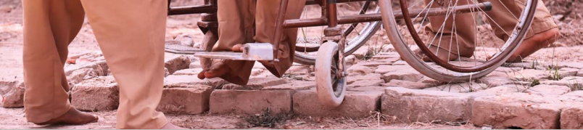
Access: Physical space
Photos: Google images and https://www.unicef.org/india/media/1191/file/Making-Schools-Accessible.pdf
Notes:
Photos: Google images and https://www.unicef.org/india/media/1191/file/Making-Schools-Accessible.pdf
Facilitator:
For this slide facilitators to ask participants :What are barriers ? Who are affected? And what are its implications?

Slide 13
Instructional barriers
Societal norms such as culture, beliefs, norms etc. can act as barriers to education for some members in that society

Slide 14
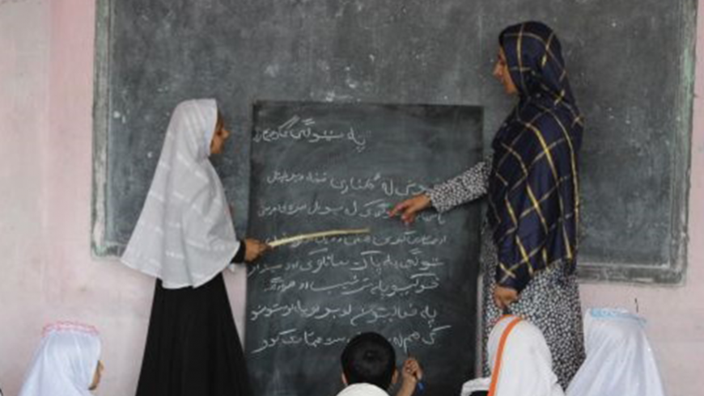
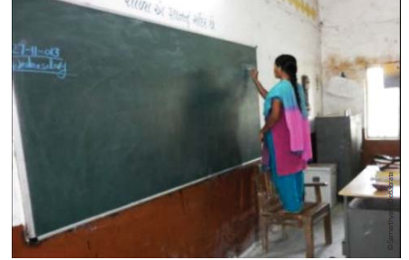
Inside classroom
Photos: Google images and https://www.unicef.org/india/media/1191/file/Making-Schools-Accessible.pdf
Notes:
Facilitator:
What alternative arrangements have the teachers made in these cases?
At the end of the PPT presentation,
Get all the participants to divide themselves into groups of 5 members wherever they are seated.
Let them discuss in their small groups and list all sorts of barriers that they know of or have experienced which prevents the children to attend school.

Slide 15
Key words to brainstorm on barriers to schooling:
TYPES OF BARRIERS
Instructional differences
Social barriers
Cultural barriers
Infrastructural Barriers
Access to educational resources: library, sports equipments, laboratory, technnology
Ambience: Noise, cleanliness,
Economic statuses
Physical/Biological
Gender
Cognitive differences
Emotional/Psychological
  low self-esteem,
  school violence and
  abusive behaviour
  LACK OF FOLLOWING FACILITIES : become barriers to some students
  Classrooms: space, equipments, visibility
  Seating facility, arrangement
  Manageable teacher – pupil ratio
  Well organised Multigrade class
  Teacher’s knowledge of Learning styles of students
  Adequate Learning pace of students
  Attendance and absenteeism
  Inefficient use of Teaching time
  Teacher efficiency
  libraries
  Teaching aids
  Print and displays
  Good laboratories,
  Availability of office staff, non-teaching staff
  Assembly and play/sports area
Notes:
To the Facilitator: Suggestion: If required this slide can be on while the participants discuss and list the barriers to schooling in the small groups.
While the groups are discussing, the facilitator should preferably go to each small group and help them think of all possible barriers associated with the key words .
If needed the facilitator can probe and ask questions to direct the thinking process

Slide 16
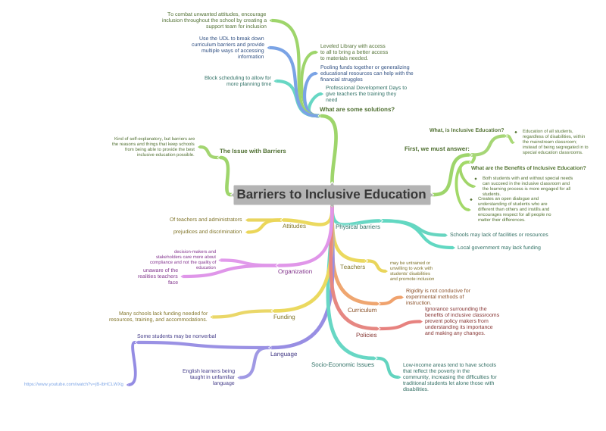
Barriers to schooling
Barriers to inclusive school (organisation, classroom, and individuals)
Notes:
Facilitator:
Preferable: this mind map on the slide is just for representation. It is desirable that the facilitator will take the picture of the mind map created in previous session and insert it here.
After the small group activity, the Facilitator flashes this slide while eliciting responses to develop a mind map. (several samples are available on the web. Trainers need to take ideas and customize it to Afghan’s context.)
The mind map can be drawn on this slide/ on a chart paper or even on a blackboard. In the end this can be photographed or a fair copy is made in the notebook /hand outs.
This session ends with the participants and facilitator together developing a mind map on barriers to schooling/education.
Facilitator will end the session by making required announcements, about lunch break formalities and the time to return after lunch.
Did You Know? Accessibility Organization for Afghan Disabled (AOAD) is a non-governmental organization established by persons with disabilities that is working as a peer-supporter and advocacy outlet in Kabul, Afghanistan

Slide 17
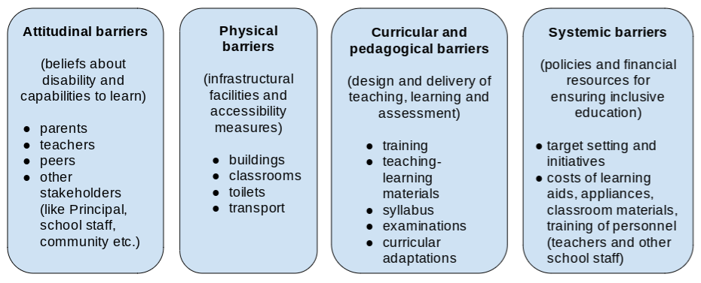
Tell me? Noticing barriers in real setting:
One real life example of a barrier you have seen or experienced in your life because of which a student dropped out of school.
To which type of barrier does this example it belong to?
Ref: Present | 02 Present | CIS01 Courseware | TISSx
Notes:
Facilitator led: Tell me? Activity. 20minutes
On day one post lunch phase, four activities are proposed.
1:Tell me? Activity to recall real life examples of barriers that led to drop out of a student 20 min
2: Developing observation check list to document barriers to education in schools and community,
3: TLC to discuss the feasibility for reducing or mitigating the barriers
Objective :
Introduction to reflecting, documenting and providing feedback.
Post warm up activity, the participants revisit their mind maps on barriers and think of real-life examples and record them in a tabular form to develop an observation checklist to record barriers to inclusion in schools.
Facilitator’s notes :
“Tell me?” is the post lunch warm-up activity related to inclusive situation: 20 minutes.
Materials needed: a Ball, a bell, chart paper, markers
Facilitators will follow the following steps.
Step 1: instruct the participants to gather in a large semi-circle (preferably facing the blackboard or the screen in the training hall).
Step 2: Any two participants are asked to volunteer to be observers and reporters. (if they wish they can add to the mind-map created in the morning on a chart paper/ blackboard)
Step 3: Instruction to participants:
“Here is a ball and a bell”.
“I will give you the ball”,
when I start ringing the bell, you take the ball, keep passing the ball. No tossing / throwing. You need to walk up to the person you choose to give the ball, hand it over and stand in their place”,
“Now that person will do the same thing, take the ball and give to any other person”,
“Do not stop as long as the bell is ringing”, (Do this five times in quick succession so they are shuffled)
Step 4: Okay, now I will add one more dimension to this. You will continue to pass the ball in the same way we did till now.
As soon as I stop/ as soon as ringing is stopped, you take the ball and say in one sentence (or communicate in any other way: home language, action, write in words, draw a picture, ) one real-life example of any of the barrier to education.
And there will be only ten rounds.
So, the condition is, each time the real-life example told by others should not be repeated.
In case if you cannot recollect any example immediately just say ‘pause’
and the chance goes to the person standing on the left of your side.
The person standing to the right side must answer the next question: To which type of barrier it belongs to?
The volunteers may include (if it’s a new one) this on a chart paper having the mind-map generated prior to lunch-break.
The game ends when we have gathered 10 different real-life examples of barriers to education.
(To start the game the ball is handed over to any one participant. It must be passed on quickly to any other by walking up to that person, hand over the ball and stand in that person’s place. The one who receives the ball will now go to any other person, hands over the ball and takes that place. This goes on. While the handing over the ball is happening, the facilitator keeps ringing the bell. When it stops, the person in whose hand the ball is will share one real life example of a barrier to education and the person standing to his/her right will identify to which group of barrier it belongs to.)
Facilator: Instruction for next activity:
“Thank you, friends. Did you enjoy? From this game we were able to hear 10 life realities about barriers to schooling. Don’t feel otherwise if you could not recollect any example or if you did not get a chance. In the next activity, you will be asked to think of maximum number of such examples . They are not only from your experience, you may even draw from any other source.
In the end ask participants to recall their best partner with whom they mutually introduced in the morning and to get back to their seats in pairs with their best partner for the next activity. For this they must keep their personal diary or worksheet , and a pen/pencil.
After the participants settle in pairs, move on to the next activity.

Slide 18
Guiding questions to prepare the draft checklist of indicators for identifying barriers:
Notes:
Facilitator: This is a paired activity. 20 minutes
Materials: PPT slide titled: Guiding questions to prepare the draft checklist of indicators for identifying barriers:
Objective of the activity: Create awareness about the indicators of barriers to schooling and to reflect on how to identify them in real situation. Preparing a checklist of indicators to find barriers to schooling in the schools and community.
Instruction to participants:
This is an opportunity for you to work with your best partner for the next 20 minutes only.
Keep your personal diary/work sheet, pen/pencil/sketch pens etc. ready
Each pair of participants may refer to the mind-map on barriers prepared today in the pre-lunch session.
They can also take cues from the questions on the ppt slide
Use the template of the table as in the ppt slide

Slide 19
Barriers in society and relations | Social | cultural | Institutional | Emotional and cognitive | Physical and cognitive | instructional | economic | gender | infrastructure
Economic divide | Education of parents | Early marriage of girls | Admission: better school/ ordinary school/ no school | Quality of support to learning | Learner centric facility matching the Learning styles | Clarity, | Poor: outfit, school accessories | International exposure/ early marriage | Access to school: ability to choose
Religious divide | status | Polygamy, lady teacher | Teacher autonomy |  | Pace of learning | rewards |  |  | Access to building
Ethnic divide |  | festivals | TPD-inclusivity | labelling |  |  |  |  | Seating in classroom
Political divide |  |  | Women teacher |  |  | Expectation, assessment |  |  | Floor, roof, walls
Access to Healthcare |  | Food habits |  |  | Attention span |  |  |  | lighting
Geographical distribution |  |  |  |  |  |  | Urban/rural |  | washroom
Means of earning livelihood | Rich, poor, middleclass |  |  |  |  |  |  |  | Water, lighting, seating, cross ventilation
Notes:
Facilitator:
Instruct the participants to think of all possible indicators of clues that help them identify the different kinds of barriers. (Below is just a sample of how you as a facilitator can get the participants to begin to think about indicators )
Example of how to explain the table:
“In this activity you will recall all the terms we used in the mind map on barriers to education.
For each term just think where and how will this become evident in the society? The cues or the indicators
Is it visible? Is it so subtle that it requires some other strategy to notice the biases?
You may think of any quality of indicators which are positive, negative, neutral, graded, happy. sad…any thing which you know of.
Explain the table:
On the left-hand vertical column. These are the larger causes for barriers which generally divide the society-Economic divide, Religious divide, Ethnic divide, Political divide, access to health care, Geographical, means of earning livelihood ”
On the Horizontal, row one: you see the broad classification of types of barriers we arrived at when we created the mind-map such as: social, cultural, institutional, emotional, cognitive, physical, instructional, economic, gender, infrastructure and so on.
Now see, in the first cell in second row you see the words Economic divide. and in rest of the cells in second row, an indicator is mentioned in relation to the barrier mentioned in the respective heading column. As you see they have been presented in a different colour just to draw your attention.
This is just an example. Each cell can have multiple entries. (Read aloud the pairs while pointing)
economic status-social barrier: education of parents,
economic status-cultural barrier: early marriage,
Economic status-institutional barrier: admission to better school/no admission to any school,
economic status-emotional and cognitive barrier: quality of support to learning,
economic status-physical and cognitive barrier: learner centric facilities matching the learning styles
economic status-Instructional barrier: clarity in communication
economic status-economic barrier: poor outfits, odd sets/broken or damaged educational accessories
economic status-gender barrier: either early marriage or send them to international schools/study abroad
economic status-infrastructure: ability to choose appropriate school
Only a few common ones are filled since the specific indicators are contextual and only the PDMs can do it collectively with the help of different stakeholders
This template is only to be used to practice thinking about looking for indicators of barriers to schooling.
“It is not necessary that all the cells may get filled when you are working in pairs”
You will get 20 minutes to work in pairs.
Presenting this the form of a table is just one way of brainstorming about indicators. You can think of any other way that is convenient to document this in your personal diaries/worksheets. You may use flowchart, pie-charts, mind maps, and so on
So, your time starts now.
While the paired team works, the facilitators will go to each group to provide need-based support.

Slide 20
Small group activity to consolidate the examples of barriers-preparation to identify indicators of barriers and presentation
Notes:
Facilitator:
Small group activity: indicator developing exercise:
Objective: To consolidate the examples of barriers and arrive at indicators to identify indicators of barriers
Materials: Personal notes, Chart paper, felt pens / markers
Instructions: Two step process:
Step-1: 20 minutes
(depending on the number of pairs) Tell three to four / pairs to re-group themselves in such a way that there need to be total of 8 or 10 individuals in each group.
Once they regroup, provide instruction to the group
Each new group with 8-10 members should prepare a consolidated checklist of indicators to identify barriers .
List all the indicators on the chart paper either in tabular or mind-map format.
Step -2: 30 minutes
Each group should share their indicators of barriers to education. And display their presentation.
Those willing to volunteer to be encouraged come forward to consolidate the presentations to make a common indicator checklist.
Following this participants get a10 minute short break.
Ask the participants to reassemble after 10 minutes:

Slide 21
Post training assignment: Read the following at your leisure:
Pandey, S., and Pandey, Y. (2017). Barrier free inclusion of learners with special educational needs in regular classroom: issues and challenges. International Journal of Education and Psychological Research, 6(2), 143-146.
Link to soft copy: 62022 Shruti 3300 (ij30) (ijepr.org)
or
https://ijepr.org/panel/assets/papers/ij30.pdf
Notes:
Materials required:
1. Chart paper / black board to record the responses of participants both during part I and II of the activity.
2. Handout for participants to read – A section extracted from the following article : Reference: Pandey, S., and Pandey, Y. (2017). Barrier free inclusion of learners with special educational needs in regular classroom: issues and challenges. International Journal of Education and Psychological Research, 6(2), 143-146.
To facilitator: this activity has two parts:
Part 1: Listening and interactive activity ( Trainer to have read the case story(given in ToT guide) and just narrate the case with voice modulation to participants.)
Part 2: Discussion-Reading-Reflection: What barriers did the case story try to address?
Prerequisite: the facilitator should preferably read the case study and the entire recommended article prior to training and prepare a narration. In addition, the trainer might also choose any one or two of such studies conveying barriers to school education for gaining in-depth understanding about barriers to inclusive schooling.
After reading, to convert the content in the case study into a narration and narrate the scenes to participants. (If possible, a few relatable picture clippings can be taken from the Afghan context and displayed as a slide to reduce verbal narration and make it more inclusive for people who prefer visual senses than auditory and for those who work with concrete objects than making meaning of abstract narrations).
Later follow it up with guided discussion with facilitator about the following:
Have you come across similar cases in your life? (Allow participants to briefly recollect similar or different cases for about 5 minutes only. This is just to help participants to discover the existence of visible and invisible barriers)
What did the story/case-study/ intend to communicate?
Was there any capture of barriers to schooling? Explain
Is this story relevant to understand barriers to schooling?
What more could have been there in the story to communicate better?
After brief discussion, distribute the handout. Allow 5 minutes to read. Continue guided discussion based on the eight key barriers mentioned in the reading. Finally end the session by asking if there were possibilities of alternative ideas which the school authorities and teachers could have used to help Fatima retain her excitement to come to school and learn along with other children?

Slide 22
Structured Reflection session
How | Why/What/Which/When | So What
Positive emotion | What went well for you? Feedback for the facilitator’s presentation
involvement | Which activity gave you insights? Which activity kept you engaged? Which aspect were difficult/easy?
Peer relationships | What was your experience in communicating? With facilitator/coparticipants
Understanding | What were your expectations for the day? What do you want to share or get clarification from the facilitator? What more are you expecting from tomorrow?
Achievement/ Accomplisment | Why are you satisfied/not satisfied? What is your take away?
Notes:
To Facilitator:
Every day ends with structured reflection of the day.
Objective:
This is to simulate the TLCs facilitated by trainers. For this all participants are required to sit in a circle along with the facilitator.
Materials: (If needed the ppt slide can be displayed)
Participants must have their pens, interactive diaries and their personal notes.
In the interactive diaries they need write to the facilitator as a feed back, seek clarification, share their points of view.
In the end the facilitator will collect their diaries and respond in writing to each one of them and return it the next day morning.
In the personal diaries the participants make notes from the discussion they carry out on the topic,
It is recommended that the Facilitator makes note of intangible feedback from participants various feelings such as happiness, disappointment etc. and use them as examples to draw their attention towards implications of barriers.
The following are some of the questions which can be kept on as a slide to facilitate the structured reflection session:

Slide 23
Conclusion
Beliefs and actions (professionalism and ethics): Honesty, commitment to profession, impartiality, and fairness.
Creative skills: Positive and conducive learning environment setting, Effective communication with students and parents
Knowledge of teaching professional tasks: Multiple teaching methods and instructional strategies to engage students in learning process effectively.

