Slide 1
Teachers’ work and wellbeing in the pandemic : A study on future of work in education
Meera Chandran, Poonam Sharma, Emaya Kannamma
Centre for Excellence in Teacher Education
Tata Institute of Social Sciences, Mumbai
Notes:
Good morning everyone
I am happy to present this paper on Teachers’ work and wellbeing in the pandemic: A study on future of work in education
This research was conducted by Meera, Poonam and myself. The paper is drawing from the larger study of Impact of the COVID-19 Pandemic on Education and Teaching in Asia-Pacific region conducted with support from Education International Asia Pacific and International Labour Organisation Bangkok.

Slide 2
Presentation Structure
Objectives
Research Design
Findings
Implications
Notes:
This presentation is structured in these 4 major sections

Slide 3
1. Objectives
To assess the impact of the school closures on employment and working conditions
Experiences of and concerns about online teaching and learning
Extent of permeation of digital technologies in education
Its implications for the future of work
Notes:
The main objectives of the study were
to assess the impact of the school closures on employment and working conditions in the education sector,
their experiences of and concerns about online teaching and learning,
the extent of permeation of digital technologies in education and
its implications for the future of work in the sector.

Slide 4
2. Research Design
Survey |  | Semi-structured Interviews
62 Quantitative items |  | 30 Questions | 23 Questions
Responses | Countries | School Teachers | Union Staff members
1862 | 22 | 7 | 9
Subregion | % Survey Responses
Pacific | 12.9
South Asia | 44.1
North Asia | 23.4
South East Asia | 19.4
West Asia | 0.2
Notes:
The research consisted of two parts: quantitative survey and qualitative interviews
The survey was administered online, it had 62 items, none of them were made mandatory. We received 1862 responses from 22 countries. The qualitative interviews were also conducted online with 7 school teachers and union staff members across as many countries. Highest proportion of responses to the survey was from South Asia, followed by North Asia.
Over 83% were in regular full time positions employed in government institutions; nearly equal percentages were from urban and rural areas (43.5 & 46.9); Slightly more male respondents (52.3) than female (46.9). 36-45 was the highest age category (34.2%). A large majority were school teachers (76.5) with a small number of head teachers and administrators. Nearly 60% worked in primary education (and 24% in secondary education). 50% had at least 16 years of experience

Slide 5
3. Findings

Slide 6
Impact on employment & working conditions
76.9%
School closures
School premises were used for community outreach services, midday meals, health provisioning, administrative work
Decrease in regular full-time employment
83.7% in government institutions
83.9% regular, full-time positions
2.8%
Change in terms & conditions of employment
49.6% shifted entirely to online mode
70.4% online/combination of online & remote
23.7% reported increased workload
16%
Notes:
Over 3/4ths of the survey respondents reported school closures. In the remaining cases too the schools were closed for teaching and remained open for health and community outreach services.
Over 80% of the respondents were employed in government institutions in regular full time positions. Yet there was a 2.8% decrease in regular full time employment
16% also reported some change in the terms and conditions of their employment. It is pertinent to note that 49% shifted entirely to the online mode. For 70% it was a combination of online and remote modes of teaching. 23.7% of them reported sudden increase in their workload.

Slide 7
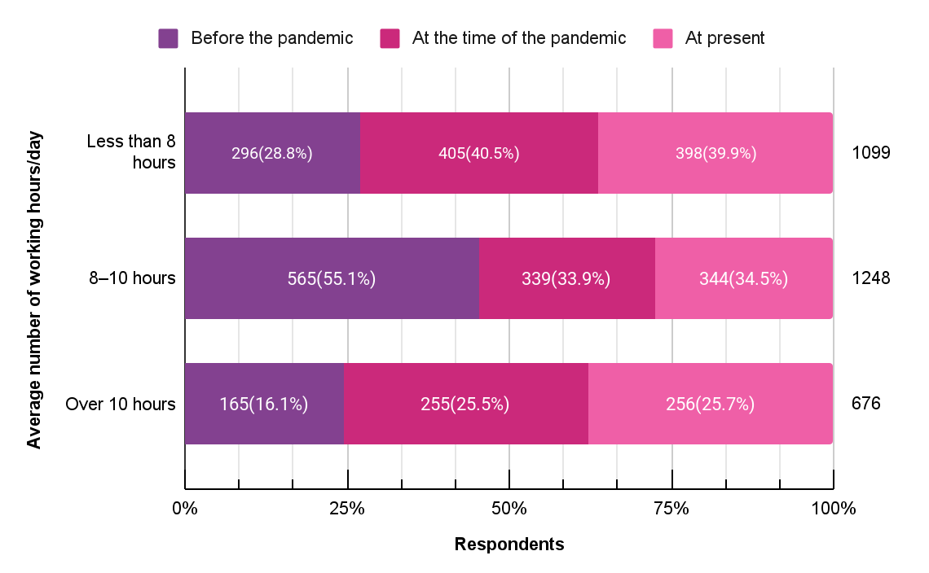
Change in working hours
Notes:
As you can see in this graph, there is a shift in the working hours.Before the pandemic a majority (55%) had worked 8-10 hours. While 16% had worked over 10 hours. In the pandemic period, those who reported working over 10 hours had increased considerably( to 25%.)
Specifically for those who reported 8-10 hours of work before the pandemic (565), we saw there was an increase in their hours of work to more than 10 hours for 24.6%.

Slide 8
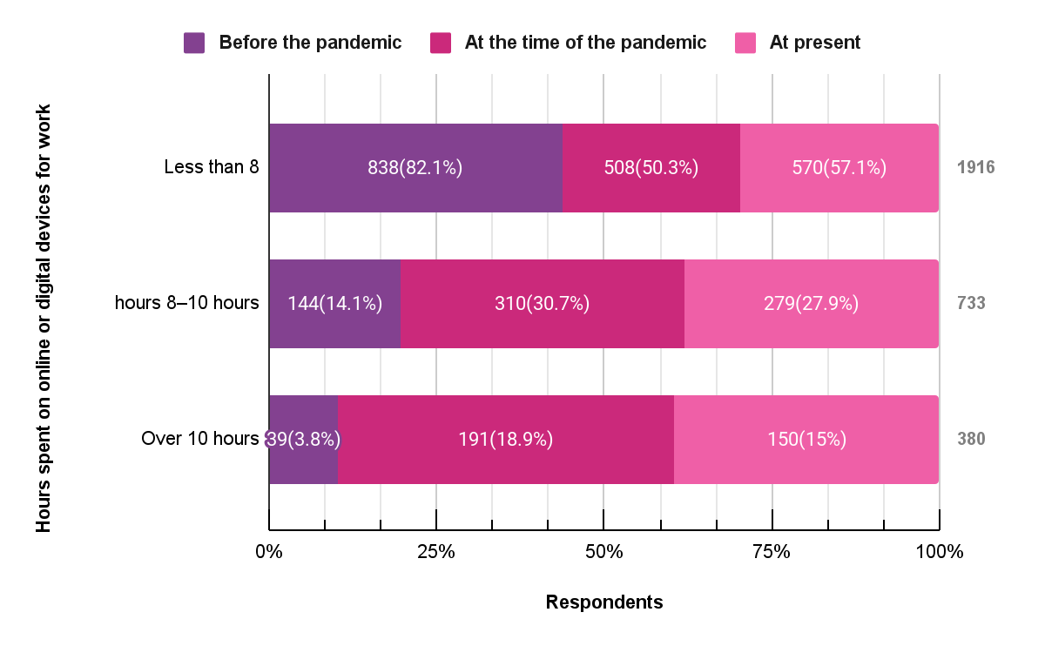
Time spent on online/digital devices for work
Notes:
Use of digital devices for work changed drastically after the pandemic with over 30% using these devices for 8-10 hours and 18% using them for over 10 hours.

Slide 9
Because they were supposed to fill up forms, give a selfie with the location (students home) and all submitted to the Department of Education. So that kind of monitoring
India union staff
..are not able to manage the basic needs to their family…not getting enough wages to survive and during class time, sometime the hackers enter into the class and they do the unnecessary activities. speak the vulgar words and disrupt the class
Union staff, Nepal
….teachers are on vacation right now, but they are very busy right now doing their performance report for the entire school year producing tons of tons of papers for that…
Union staff, Philippines
‘Teaching..complicated
process involving emotional relationships, intellectual interactions, group dynamics
and the exercise of practical judgment in constantly changing circumstances’
Seddon and Palmieri (2009)
Notes:
With such abrupt shift and intensification of work, teachers were faced with new challenges on digital mode as mentioned in the interviews. They expressed their discontent with their work being scrutinised with higher surveillance and monitoring aided by technology, This kind of quality or performance standards associated with monitoring, has resulted in a lot of paper work to be done by teachers. This growth of reporting and administrative work to serve accountability demands breaks down teachers holistic work into detailed subtasks. That indicates deskilling of teachers work. And disregards the relational aspect and complex processes involved in their work.

Slide 10
Economic impact
Worried about losing jobs
Heightened anxiety related to job security
Corresponds with proportion of contractual positions
46.7% stressed about future of career
23.2%
Reduction in compensation
Caused economic distress
25.4% increased expenses due to covid related preventive measures
12.5% increased medical expenses
9.5% reduction in salary/ job losses in family
21.8%
Spent on devices & materials for work & not reimbursed
These included smartphones, laptops & internet devices for 15-17%
54.6%
Notes:
There were overriding economic concerns - it is striking that 23% expressed concerns about losing their job. There was heightened anxiety about job security and 46% clearly said they had concerns about the future of their career. Note that a majority were also mid-career teachers.
21.8% had actually faced some form of pay cut. While at the same time for about 1-4ths there was increased health care expenses. Specifically, 9.5% had faced job loss in their own family
The major chunk of expenses was on digital devices for work. 54.6% had such expenditures not reimbursed by their institution. That includes smartphones, laptops, internet devices, etc.

Slide 11
Experiences & concerns about
quality of teaching & wellbeing
Not able to work efficiently
42.7%
32.1% decline in quality of work
Accompanied by concerns about job security
Mode of teaching-learning
was online
23.8%
28.1%
Lack of interactions with co-workers or students - topmost concern
Personal health & safety emerged as top concern
But resources
used were conventional - textbooks
Increased workload for 16%
Change in nature of work for 15%.
Student learning 27.5%
Emotional wellbeing 14.5%
Notes:
Most teachers we interviewed felt that they did not have access to adequate resources online for their teaching and relied on textbooks.
Despite their best efforts 42.7% expressed dissatisfaction with themselves and said they were unable to work efficiently. 32% said there was decline in their own quality of work. The topmost concern for many was the lack of interactions with co workers and their students, the relational aspect of teaching that gets sidelined in discourses of outcomes driven standardisation of teachers work. This was followed by concerns about increased workload and change in nature of their work.

Slide 12
there's no delineation between the office work and personal time… there's a fear, they may get orders as early as 6am. As late as midnight... things are getting instant …
Fiji Teacher
…teachers were forced to create their own module, printed and, delivered to our students…these are not under the work, our teachers, this should be processed and prepared by the central office, and our teachers are only supposedly to teach now. But right now our teachers are asked to go to school and to do the printing and binding of the module….
Philippines union staff
.they were made to work on different tasks, which were never related to their profession, because the schools were closed, and they are the government employees.. posted at airports and distributing food …thermal scanning at the airport, or managing the quarantine centers. So this kind of things have really, you know, created dissatisfaction among the teachers…
India , Union staff
Notes:
Along with that the frustration at not having the time to teach because of all the administrative responsibilities and Covid duties- came through clearly.
The interview participants were able to expand on their experiences of working during the pandemic - the exhausting nature of a teachers’ job, being on calls throughout the the day trying to reach out to students and parents; Adding to that was being constantly available and inability to properly disconnect from work.

Slide 13
Access
ICT Competencies
43% laptops/ computers
Lowest availability in South Asia
Increase in use of digital devices, online modes
4.5 times video contact
2.7 times learning management systems
1.8 times digital learning software
33.7% smartphone
Most accessed in South Asia
Devices provided by institutions
North Asia - 69.3%
South Asia - 27.4%
Ranking themselves advanced beginners or novices
43.5% digital skills
41.5 % laptops, device most needed for work
Internet
80.4 % challenging
Notes:
With such reliance on digital and online medium for teaching during the pandemic, if we see in terms of actual access we find that 43% respondents had laptops or computers; 33% used smartphones as their device for work. There was quite a bit of regional variations in this regard.
Accessing internet for work is the most challenging thing for over 80%.
Despite these limitations the permeation of digital technologies is quite high. There has been two fold or 4 fold increase in use of digital softwares and learning management systems. In contrast, the self assessment shows that most people ranked themselves as either novices or beginners in using the technologies.

Slide 14
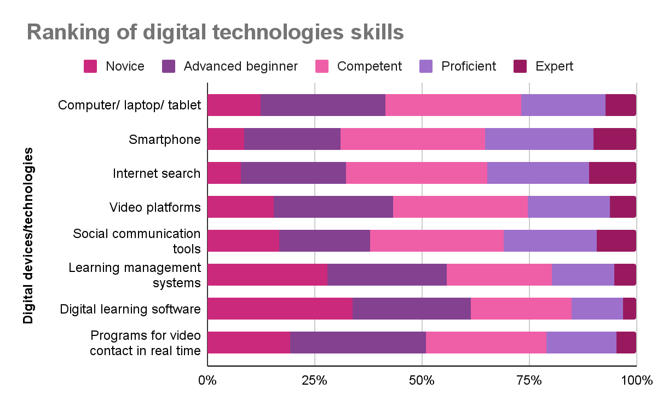
Notes:
A closer look at the self rating of competence in digital technologies and skills shows For smartphones and internet search most have rated themselves as competent or higher. But for the remaining, including computers and laptops, a majority have ranked themselves as novices or advanced beginners. The contrast here is quite stark. There is high permeation and demand for use of digital technologies and ed tech platforms but the access to appropriate computing devices and competence in using these are quite low.

Slide 15
Professional development opportunities
67.6%
80.6%
Learnt on their own, with some help from others or at their own cost to use digital technology
Lack of professional development opportunities was a challenge
Despite low level of self reported competence
Highly challenging 24.9% +
Somewhat challenging 55.7%
Notes:
When we look at the support with professional development opportunities in using the devices and education technologies for work that about 67.6% learnt on their own despite low level of self reported competence. 80.6% shared that lack of professional development was a challenge for them.
So clearly there is a large gap between the professional development needs and provision.

Slide 16
Lower
the competence & professional development opportunities
Higher
the fear of being unprepared for work in future
Notes:
There were two aspects the survey touched upon - their self competence and fears about future of work. We compared these two responses and find that among those who reported fears of being unprepared for the future of work, a large percentage had also reported themselves to be novices in using digital technologies.

Slide 17
Support for teachers in their online/remote mode of work
“being a part of union allowed to have a strong organised presence and to collectively raise issues with concerned authorities”
Peers / Colleagues
Job losses, pay cuts, health care, professional development, internet allowance, purchase of devices
Biggest support from colleagues experiencing similar hardships; could share and learn from knowledgeable peers
Union
Health emergencies, professional and legal support
Salary-related issues, curriculum changes for teacher’s education - India
Curriculum reduction for students - Australia, Indonesia
Online parent-teacher meetings, loan availability- Fiji
Non-teaching days, training support - Australia
internet budgets - Indonesia, Malaysia, the Philippines
Family members
Digital skills and support during online teaching
Emotional support
Notes:
There were three sources of support reported by our participants - the majority was peer support and support of family members.
Peer networks emerge as quite invaluable in providing quick support both at the personal and professional fronts during the challenging times.
Being part of the union gave members a sense of community, voice and at times legal redress for issues such as job losses and pay cuts. Paring down the syllabus, budgetary allocation for internet was achieved in some places.

Slide 18
teachers are not used to using the new platforms. The platform itself is not well organized to be used
-Teacher, Japan
...community and society really need to recognize teachers, for the complex work that they do, it's time that they support us and respect our profession
Teacher, Australia
teachers are looking at the family members…they really need support in learning how to use internet and have access to internet that's
Indonesia_Union Member
Notes:
Participants in interviews were quite vocal in sharing the concerns and areas where they needed support. There was also call for the system to recognise the complex nature of teachers’ work and respect for the profession.
Clearly, they felt teachers must have job security and freedom from constant worries of job loss. There is need to reimagine the roles of teachers for the future and make sure they are being prepared accordingly.

Slide 19
Respondents with direct experience of teaching
Sources of professional support
Formal avenues for professional development emerge as a high priority
For a majority of respondents (53.9%) teaching learning with respect to managing and orchestrating digital technologies was a high priority
30% individual efforts by reaching out to colleagues
21% their institution
20.1% unions
14.3% professional groups
Notes:
There was a section in the survey for those with direct teaching experience during the pandemic. For many, professional support was absent - they had to get issues addressed through individual efforts or by reaching out to the peer group. It was the expertise within the peer group that emerges as the main source of support. Some had Institutional support, support from union and professional groups.
It is not surprising that formal avenues for professional development in nearly all aspects of digital technologies for teaching and learning emerge as a high priority for teachers.

Slide 20
Respondents with direct experience of teaching
Games
Group messaging on WhatsApp Telegram
Used Padlet MentimeterKahoot
Hands-on activities
Teachers created, curated videos & audio content
Involved parents
Small groups
Notes:
Once again despite severe limitations teachers shared strategies they had devised, resources they had used and content they had curated to ensure their students had a good interactive learning experience online.

Slide 21
Future of Work
Main concerns for who were ‘not prepared for the future of work’,
increased workload
lack of interactions
change in nature & content of work
Requirements for future of work
professional knowledge
technical support
access to ICT devices
88.4% digital technologies would continue into future of work
25.4% well-prepared for future of work
Notes:
The almost unanimous view of those who took the survey was that digital technologies are here to stay. But, only 25.4% said they were well prepared for the future of work.
The main requirements for the future of work was professional knowledge, technical support and access to ICT devices.

Slide 22
4. Implications
Investment in teachers
Access to digital devices for work
Better pay & health insurance
Professional development in digital technology
Recognition of teacher communities
Recognition for teachers’ work
Involvement of teachers and their unions in social and policy dialogue
Notes:
These findings have specific implications for policy and programmatic action:
1.Investment in teachers by providing requisite devices, better pay and health insurance
2.technical support, and need based professional development.
3.Extension of support to teacher communities of practice and continuing professional development through peer groups and networks.
4. Recognition of teachers who served under great stress with little support as frontline workers.
5.Inclusion of teachers and their representatives in policy development and decision-making as the education sector takes on the challenges of a post pandemic world.

