Slide 1
Impact of the Covid-19 Pandemic on Education and Teaching in Asia-Pacific: Future of Work in Education
Meera Chandran, Poonam Sharma, Emaya Kannamma
Centre for Excellence in Teacher Education
Tata Institute of Social Sciences, Mumbai

Slide 2
1. Objectives
Impact of the pandemic & school closures on employment & working conditions in the education sector
Shift to online/remote mode of teaching, experiences & concerns about quality of teaching & wellbeing
Extent of technological permeation in schooling with a focus on access to digital tools, competencies, training & support
Support for teachers and education personnel with regard to online / remote mode of work
Professional development opportunities of teachers, concerns about working conditions & future of work
Notes:
The study investigated the impact of school closures and migration to online mode of work on teachers’ work and wellbeing during the pandemic. We wished to understand extent of use of digital technologies & Edtech, teachers’ experiences in the online mode, their challenges, the kind of support and professional development they received and their concerns about the future of their work.

Slide 3
2. Research Design
Survey |  |  | Semi-structured Interviews
62 Quantitative items |  |  | 30 Questions | 23 Questions
Responses | Countries | Member Organisations | School Teachers | Union Staff members
1862 | 22 | 42 | 7 | 9
Subregion | % Survey Responses
Pacific | 12.9
South Asia | 44.1
North Asia | 23.4
South East Asia | 19.4
West Asia | 0.2
Notes:
Findings of presented here is based upon 1862 survey responses from 22 countries representing 42 EI member organisations. As well as qualitative interviews with 7 school teachers and 9 union staff members across 7 countries. Highest proportion of responses to the survey was from South Asia 44%; followed by North Asia 23%, South East Asia 19% and Pacific 12.9%.
Over 83% were in regular full time positions employed in government institutions; more or less evenly distributed across male female, urban-rural. 3/4ths were school teachers, 60% employed in primary education. 50% had at least 16 years of experience

Slide 4
Impact on employment & working conditions
76.9%
School closures
School premises were used for community outreach services, midday meals, health provisioning, administrative work
Decrease in regular full-time employment
83.7% in government institutions
83.9% regular, full-time positions
2.8%
Change in terms & conditions of employment
49.6% shifted entirely to online mode
70.4% online/combination of online & remote
23.7% reported increased workload
16%
Notes:
Over 3/4ths of our survey respondents reported school closures. In the remaining cases too the schools were closed for classes but remained open for health and community outreach services - which many of the teachers also took part in.
There was 2.8% decrease in regular full time employment, for 16% there was some change in the terms and conditions of their employment.
Pertinently, 49% were required to migrate entirely to the online mode during the pandemic. For 70% it was a combination of online and remote modes of teaching. 23.7% of them reported sudden increase in their workload.

Slide 5
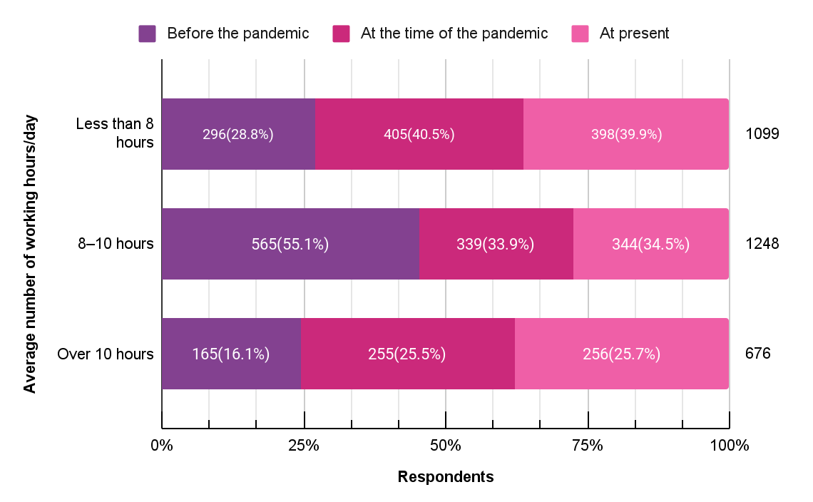
Change in working hours
Notes:
As you can see in this graph, there is a distinct shift in the number of hours of work. Before the pandemic a majority (55%) had worked 8-10 hours and 16% had worked over 10 hours. In the pandemic period, there was a 10% increase in those those who reported working over 10 hours.
Among those who reported 8-10 hours of work before the pandemic (565), for about 25% of them it increased to more than 10 hours.

Slide 6
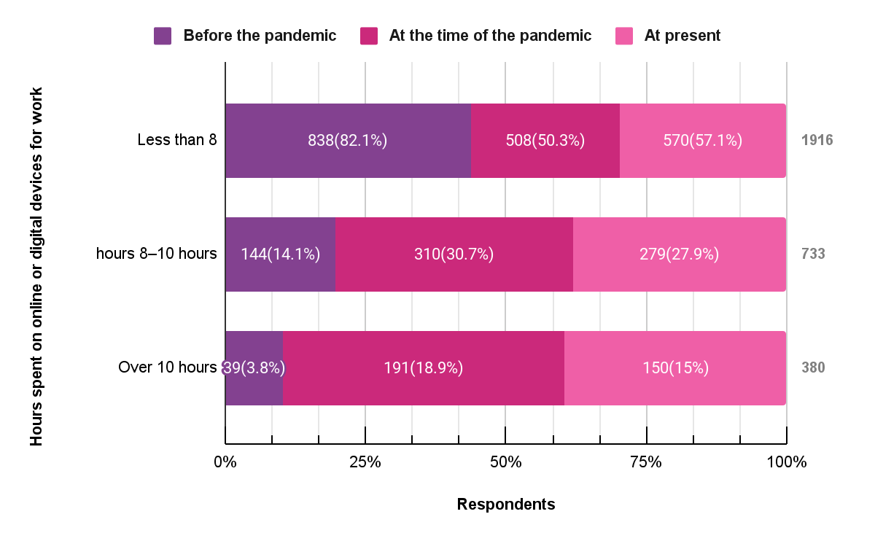
Time spent on online/digital devices for work
Notes:
Use of digital devices for work changed drastically after the pandemic with over 30% using these devices for 8-10 hours and 18% using them for over 10 hours.

Slide 7
Teachers are teaching....from 8-5. They've been entertaining questions and calls throughout the day and throughout the night, because that depends on when the parents are available to communicate with the teacher…
(Union staff, Philippines)
...community and society really need to recognize teachers, for the complex work that they do, it's time that they support us and respect our profession
Teacher, Australia
it's not that teachers are not interested in teaching ...but they are assigned other non teaching assignments...as they are government servants
Union Staff, India
Notes:
During interviews we could hear about the exhausting nature of a teachers’ job - being on calls throughout the the day trying to reach out to students and parents etc.;
They wanted the administrators in the system to recognise the complex nature of teachers’ work and demanded respect for the profession. Their frustration at not having the time to teach because of all the administrative responsibilities - came through clearly.

Slide 8
Economic impact
Worried about losing jobs
Heightened anxiety related to job security
Corresponds with proportion of contractual positions
46.7% stressed about future of career
23.2%
Reduction in compensation
Caused economic distress
25.4% increased expenses due to covid related preventive measures
12.5% increased medical expenses
9.5% reduction in salary/ job losses in family
21.8%
Spent on devices & materials for work & not reimbursed
These included smartphones, laptops & internet devices for 15-17%
54.6%
Notes:
There were overriding economic concerns - 23% expressed concerns about losing their job. There was heightened anxiety about job security - 46% clearly said they had concerns about the future of their career. We must note, that a majority were also mid-career teachers.
21.8% had actually faced some form of pay cut. While at the same time for about 1-4ths there were increased health care expenses.
As high as 54.6% had out of pocket expenses on digital devices such as laptops, smartphones, internet devices etc. for work not reimbursed by their institution.

Slide 9
Experiences & concerns about
quality of teaching & wellbeing
Not able to work efficiently
42.7%
32.1% decline in quality of work
Accompanied by concerns about job security
Mode of teaching-learning
was online
23.8%
28.1%
Lack of interactions with co-workers or students - topmost concern
Personal health & safety emerged as top concern
But resources
used were conventional - textbooks
Increased workload for 16%
Change in nature of work for 15%.
Student learning 27.5%
Emotional wellbeing 14.5%
Notes:
Most teachers we interviewed felt that they did not have access to adequate resources online for their teaching and even in the online mode, they relied on textbooks.
Despite their best efforts 42.7% expressed dissatisfaction with themselves and said they were unable to work efficiently. 32% said there was decline in their own quality of work. The topmost concern for many was the lack of interactions with co workers and their students & concerns about increased workload and change in nature of their work.

Slide 10
teachers are not used to using the new platforms. The platform itself is not well organized to be used
Teacher, Japan
...not all students are attending zoom classes, as their parents cannot afford to pay for data ...these students are provided with hard copy of the worksheets, we contact the parents and handover the copies
Teacher, Fiji
Most teachers in remote areas have limited internet access. Teachers in the remote areas, or even in the city require laptop with high storage to save students work. All teachers need more budget for internet.
Union staff, Indonesia
Notes:
Teachers expressed dissatisfaction with their own quality of work - despite working hard. They spoke of parents who could not afford data for online learning. Teachers’ reached out to such parents and provided the hard copies of worksheets. For teachers too the digital platforms were new and unfamiliar and they found them not very conducive for teaching. The teachers themselves were in remote areas with connectivity issues, they did not have requisite devices or even storage in their computers.

Slide 11
Access
ICT Competencies
43% laptops/ computers
Lowest availability in South Asia
Increase in use of digital devices, online modes
4.5 times video contact
2.7 times learning management systems
1.8 times digital learning software
33.7% smartphone
Most accessed in South Asia
Devices provided by institutions
North Asia - 69.3%
South Asia - 27.4%
Ranking themselves advanced beginners or novices
43.5% digital skills
41.5 % laptops, device most needed for work
Internet
80.4 % challenging
Notes:
All of what we presented so far clearly shows the high reliance on digital and online medium for teaching during the pandemic. But this is based on low access to adequate devices - only 43% respondents had laptops or computers; 33% used smartphones as their device for online / remote work. There were large regional variations here: Smartphone use for work was highest in South Asia at 36.9% followed by South East Asia at 28%. Devices were mostly provided by the institutions in North Asia 69% but only for 27% of them in south Asia.
Accessing internet for work was most challenging for over 80%.
Despite these limitations the permeation of digital technologies has been two fold or 4 fold - maily in use of digital softwares and learning management systems.

Slide 12
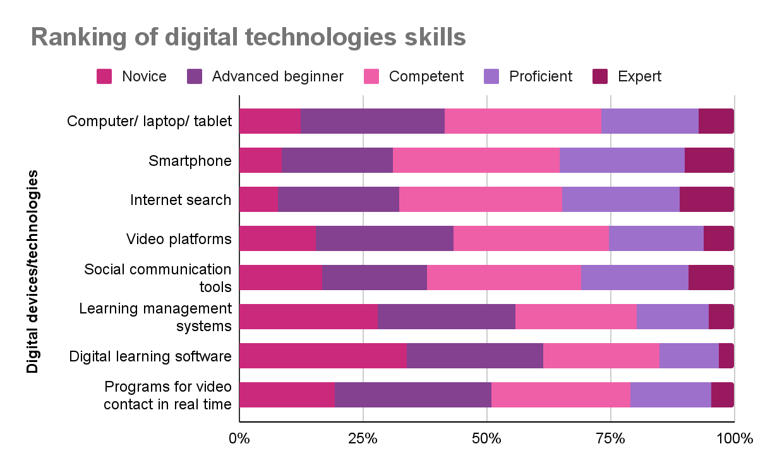
Notes:
Conversely the self assessment shows that most people ranked themselves as either novices or beginners in using the Edtech technologies.
- For smartphones and internet search most have rated themselves as competent or higher. But for the remaining, including computers and laptops, and other kinds of digital technologies, a majority have ranked themselves as novices or advanced beginners.

Slide 13
Professional development opportunities
67.6%
80.6%
55%
27.8%
Learnt on their own, with some help from others or at their own cost to use digital technology
Lack of professional development opportunities was a challenge
Availed professional development in using digital technologies
Received professional development opportunities from their institutions
Highly challenging 24.9% +
Somewhat challenging 55.7%
37.4% had not received any such training
Govt departments 21.2%
Unions 12.2%
Despite low level of self reported competence
Notes:
If we look at the level of support and professional development opportunities in using the digital devices and Edtech - We see that about 67.6% learnt on their own. 80.6% said lack of professional development was a challenge for them.
55% did say they had availed professional development - 27% of them had received this from their own institutions.
So clearly there is a large gap between the professional development needs and provisioning.

Slide 14
Lower
the competence & professional development opportunities
Higher
the fear of being unprepared for work in future
Notes:
Survey responses clearly indicated that those who reported low level of professional competence in using digital technologies & lack of professional development opportunities, were more likely to report fear of being unprepared for future of work.

Slide 15
Support for teachers in their online/remote mode of work
“being a part of union allowed to have a strong organised presence and to collectively raise issues with concerned authorities”
Peers / Colleagues
Job losses, pay cuts, health care, professional development, internet allowance, purchase of devices
Biggest support from colleagues experiencing similar hardships; could share and learn from knowledgeable peers
Union
Health emergencies, professional and legal support
Salary-related issues, curriculum changes for teacher’s education - India
Curriculum reduction for students - Australia, Indonesia
Online parent-teacher meetings, loan availability- Fiji
Non-teaching days, training support - Australia
internet budgets - Indonesia, Malaysia, the Philippines
Family members
Digital skills and support during online teaching
Emotional support
Notes:
The main source of support for a majority was peer support, support of family members, and support from their respective unions.
Peer networks emerged as quite invaluable in providing quick support both at the personal and professional fronts during the challenging times.
Being part of the union gave members a sense of community, voice and legal redress at a time of job losses and pay cuts. They could bargain for paring down the syllabus, budgetary allocation for internet in few places.

Slide 16
..not only the teachers who are teaching but those who are at home and not getting work.. .need to get basic help from the government and school management for their survival...
Union staff, Nepal
Teachers need to get enough training in technology and they need to be confident that they are in their job without any disturbances and fear of being terminated from the job, such stress should not be there
Union staff, Nepal
The role of teachers will continue they will have to adapt and grow along… teachers of the future must be prepared to be data collectors as well as analysts, planners, collaborators, and curricular expert problem solvers
Union staff, Malaysia
Notes:
In the interviews people were quite vocal about their concerns and areas for support. Clearly, teachers must have job security and freedom from constant worries of job loss.

Slide 17
Respondents with direct experience of teaching
Sources of professional support
Formal avenues for professional development emerge as a high priority
For a majority of respondents (53.9%) teaching learning with respect to managing and orchestrating digital technologies was a high priority
30% individual efforts by reaching out to colleagues
21% their institution
20.1% unions
14.3% professional groups
Notes:
In terms of online teaching, professional support for work was absent for many- they had to get issues addressed through either individual efforts or from their peer group. Some had Institutional support, support from union and professional groups.
Formal avenues for professional development in nearly all aspects of digital technologies for teaching and learning emerge as a high priority for teachers.

Slide 18
Respondents with direct experience of teaching
Games
Group messaging on WhatsApp Telegram
Used Padlet MentimeterKahoot
Hands-on activities
Teachers created, curated videos & audio content
Involved parents
Small groups
Notes:
Despite severe limitations teachers shared strategies they had devised, resources they had used and content they had curated to ensure their students had a good interactive learning experience online.

Slide 19
Future of Work
Main concerns for who were ‘not prepared for the future of work’,
increased workload
lack of interactions
change in nature & content of work
Requirements for future of work
professional knowledge
technical support
access to ICT devices
88.4% digital technologies would continue into future of work
25.4% well-prepared for future of work
Notes:
The almost unanimous view of those who took the survey was that digital technologies are here to stay. But only 25.4% said they were well prepared for the future of work.
The main requirements for the future of work was professional knowledge, technical support and access to ICT devices.

Slide 20
4.Recommendations
Access to digital devices for work
Better pay & health insurance
Professional development in digital technology
Recognition of teacher communities
Recognition for teachers’ work
Involvement of teachers and their unions in social and policy dialogue
Notes:
As we see, there is high permeation and demand for use of digital technologies and Edtech platforms but the access to appropriate computing devices and competence in using these are quite low. And the professional support to teachers to respond to this challenge is also very weak. Thereby heightening their fears about the future of their work.
Therefore we propose these recommendations.
Thank you.

