Slide 1
Impact of the Covid-19 Pandemic on Education and Teaching in Asia-Pacific: Future of Work in Education
Meera Chandran, Poonam Sharma, Emaya Kannamma
Centre for Excellence in Teacher Education
Tata Institute of Social Sciences, Mumbai

Slide 2
1. Objectives
Impact of the pandemic & school closures on employment & working conditions in the education sector
Shift to online/remote mode of teaching, experiences & concerns about quality of teaching & wellbeing
Extent of technological permeation in schooling with a focus on access to digital tools, competencies, training & support
Support for teachers and education personnel with regard to online / remote mode of work
Professional development opportunities of teachers, concerns about working conditions & future of work

Slide 3
2. Research Design
Survey |  |  | Semi-structured Interviews
62 Quantitative items |  |  | 30 Questions | 23 Questions
Responses | Countries | Member Organisations | School Teachers | Union Staff members
1862 | 22 | 42 | 7 | 9
Subregion | % Survey Responses
Pacific | 12.9
South Asia | 44.1
North Asia | 23.4
South East Asia | 19.4
West Asia | 0.2

Slide 4
Impact on employment & working conditions
76.9%
School closures
School premises were used for community outreach services, midday meals, health provisioning, administrative work
Decrease in regular full-time employment
83.7% in government institutions
83.9% regular, full-time positions
2.8%
Change in terms & conditions of employment
49.6% shifted entirely to online mode
70.4% online/combination of online & remote
23.7% reported increased workload
16%

Slide 5
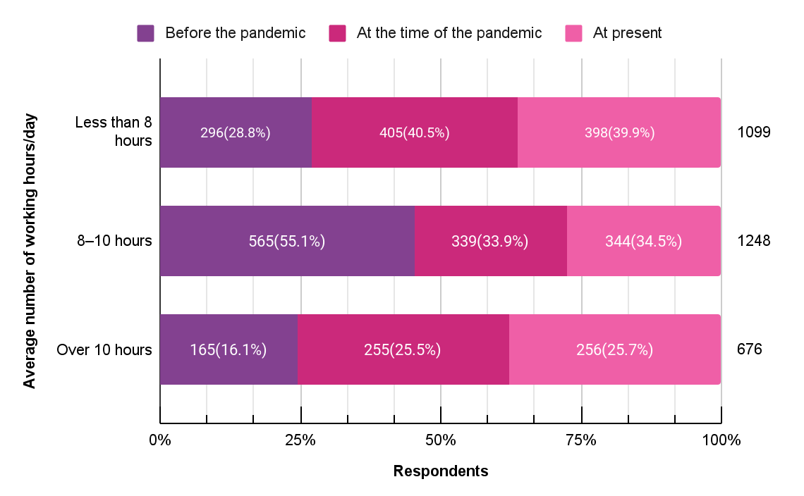
Change in working hours

Slide 6
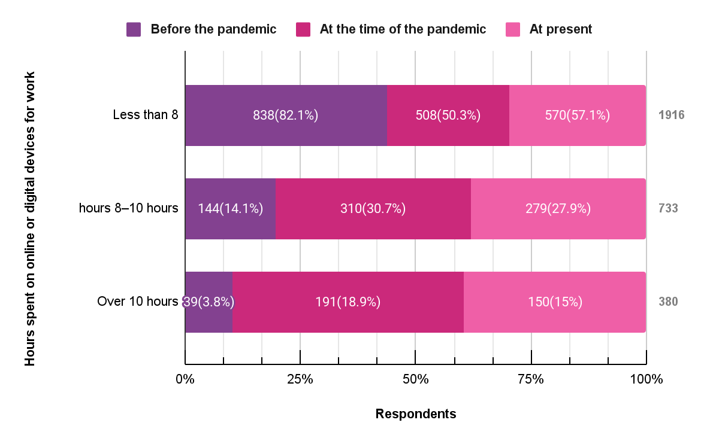
Time spent on online/digital devices for work

Slide 7
Teachers are teaching....from 8-5. They've been entertaining questions and calls throughout the day and throughout the night, because that depends on when the parents are available to communicate with the teacher…
(Union staff, Philippines)
...community and society really need to recognize teachers, for the complex work that they do, it's time that they support us and respect our profession
Teacher, Australia
it's not that teachers are not interested in teaching ...but they are assigned other non teaching assignments...as they are government servants
Union Staff, India
Notes:
.

Slide 8
Economic impact
Worried about losing jobs
Heightened anxiety related to job security
Corresponds with proportion of contractual positions
46.7% stressed about future of career
23.2%
Reduction in compensation
Caused economic distress
25.4% increased expenses due to covid related preventive measures
12.5% increased medical expenses
9.5% reduction in salary/ job losses in family
21.8%
Spent on devices & materials for work & not reimbursed
These included smartphones, laptops & internet devices for 15-17%
54.6%

Slide 9
Experiences & concerns about
quality of teaching & wellbeing
Not able to work efficiently
42.7%
32.1% decline in quality of work
Accompanied by concerns about job security
Mode of teaching-learning
was online
23.8%
28.1%
Lack of interactions with co-workers or students - topmost concern
Personal health & safety emerged as top concern
But resources
used were conventional - textbooks
Increased workload for 16%
Change in nature of work for 15%.
Student learning 27.5%
Emotional wellbeing 14.5%

Slide 10
teachers are not used to using the new platforms. The platform itself is not well organized to be used
Teacher, Japan
...not all students are attending zoom classes, as their parents cannot afford to pay for data ...these students are provided with hard copy of the worksheets, we contact the parents and handover the copies
Teacher, Fiji
Most teachers in remote areas have limited internet access. Teachers in the remote areas, or even in the city require laptop with high storage to save students work. All teachers need more budget for internet.
Union staff, Indonesia

Slide 11
Access
ICT Competencies
43% laptops/ computers
Lowest availability in South Asia
Increase in use of digital devices, online modes
4.5 times video contact
2.7 times learning management systems
1.8 times digital learning software
33.7% smartphone
Most accessed in South Asia
Devices provided by institutions
North Asia - 69.3%
South Asia - 27.4%
Ranking themselves advanced beginners or novices
43.5% digital skills
41.5 % laptops, device most needed for work
Internet
80.4 % challenging

Slide 12
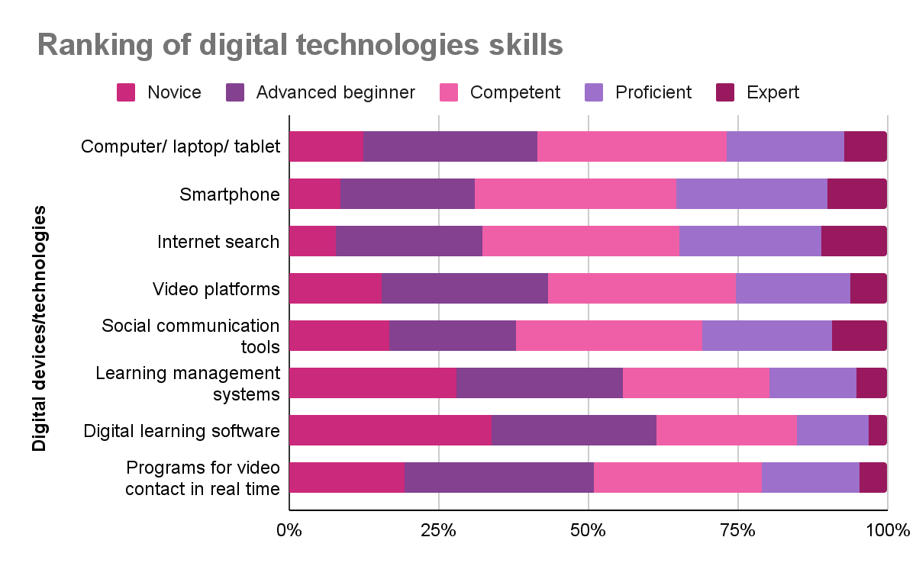

Slide 13
Professional development opportunities
67.6%
80.6%
55%
27.8%
Learnt on their own, with some help from others or at their own cost to use digital technology
Lack of professional development opportunities was a challenge
Availed professional development in using digital technologies
Received professional development opportunities from their institutions
Highly challenging 24.9% +
Somewhat challenging 55.7%
37.4% had not received any such training
Govt departments 21.2%
Unions 12.2%
Despite low level of self reported competence

Slide 14
Lower
the competence & professional development opportunities
Higher
the fear of being unprepared for work in future

Slide 15
Support for teachers in their online/remote mode of work
“being a part of union allowed to have a strong organised presence and to collectively raise issues with concerned authorities”
Peers / Colleagues
Job losses, pay cuts, health care, professional development, internet allowance, purchase of devices
Biggest support from colleagues experiencing similar hardships; could share and learn from knowledgeable peers
Union
Health emergencies, professional and legal support
Salary-related issues, curriculum changes for teacher’s education - India
Curriculum reduction for students - Australia, Indonesia
Online parent-teacher meetings, loan availability- Fiji
Non-teaching days, training support - Australia
internet budgets - Indonesia, Malaysia, the Philippines
Family members
Digital skills and support during online teaching
Emotional support

Slide 16
..not only the teachers who are teaching but those who are at home and not getting work.. .need to get basic help from the government and school management for their survival...
Union staff, Nepal
Teachers need to get enough training in technology and they need to be confident that they are in their job without any disturbances and fear of being terminated from the job, such stress should not be there
Union staff, Nepal
The role of teachers will continue they will have to adapt and grow along… teachers of the future must be prepared to be data collectors as well as analysts, planners, collaborators, and curricular expert problem solvers
Union staff, Malaysia

Slide 17
Respondents with direct experience of teaching
Sources of professional support
Formal avenues for professional development emerge as a high priority
For a majority of respondents (53.9%) teaching learning with respect to managing and orchestrating digital technologies was a high priority
30% individual efforts by reaching out to colleagues
21% their institution
20.1% unions
14.3% professional groups

Slide 18
Respondents with direct experience of teaching
Games
Group messaging on WhatsApp Telegram
Used Padlet MentimeterKahoot
Hands-on activities
Teachers created, curated videos & audio content
Involved parents
Small groups

Slide 19
Future of Work
Main concerns for who were ‘not prepared for the future of work’,
increased workload
lack of interactions
change in nature & content of work
Requirements for future of work
professional knowledge
technical support
access to ICT devices
88.4% digital technologies would continue into future of work
25.4% well-prepared for future of work

Slide 20
4.Recommendations
Access to digital devices for work
Better pay & health insurance
Professional development in digital technology
Recognition of teacher communities
Recognition for teachers’ work
Involvement of teachers and their unions in social and policy dialogue

