Slide 1
Impact of the Covid-19 Pandemic on Education and Teaching in Asia-Pacific: Future of Work in Education
Meera Chandran, Poonam Sharma, Emaya Kannamma
Centre for Excellence in Teacher Education
Tata Institute of Social Sciences, Mumbai
Notes:
Good morning and Good afternoon everyone.
I am very happy to present this report on Impact of the covid -19 pandemic on education and teaching in Asia Pacific: Future of work in education.
This research was conducted by Poonam, Emaya and myself.

Slide 2
Presentation Structure
Objectives
Research Design
Findings
Recommendations
Notes:
In this presentation we share with you the objectives, research design, findings and recommendations that emerge from the study

Slide 3
1. Objectives
Impact of the pandemic & school closures on employment & working conditions in the education sector
Shift to online/remote mode of teaching, experiences & concerns about quality of teaching & wellbeing
Extent of technological permeation in schooling with a focus on access to digital tools, competencies, training & support
Support for teachers and education personnel with regard to online / remote mode of work
Professional development opportunities of teachers, concerns about working conditions & future of work
Notes:
The objectives of the study were to investigate the following:
Impact of the pandemic & school closures on employment & working conditions in the education sector
Shift to online/remote mode of teaching, experiences & concerns about quality of teaching & wellbeing
Extent of technological permeation in schooling with a focus on access to digital tools, competencies, training & support
Support for teachers and education personnel with regard to online / remote mode of work
Professional development opportunities of teachers, concerns about working conditions & future of work

Slide 4
2. Research Design
Survey |  |  | Semi-structured Interviews
62 Quantitative items |  |  | 30 Questions | 23 Questions
Responses | Countries | Member Organisations | School Teachers | Union Staff members
1862 | 22 | 42 | 7 | 9
Subregion | % Survey Responses
Pacific | 12.9
South Asia | 44.1
North Asia | 23.4
South East Asia | 19.4
West Asia | 0.2
Notes:
The research consisted of two parts: the quantitative survey and qualitative interviews:
The quantitative survey was administered online, it had 62 items, none of them were made mandatory. We received 1862 responses from 22 countries representing 42 EI member organisations. The qualitative interviews were also conducted online with 7 school teachers and union staff members across as many countries. Highest proportion of responses to the survey was from Soutn Asia 44% followed by North Asia at 23%, South East Asia at 19% and Pacific 12.9%.
Over 83% were in regular full time positions employed in government institutions; nearly equal percentages were from urban and rural areas (43.5 & 46.9); Slightly more male respondents (52.3) than female (46.9). 36-45 was the highest age category (34.2%). A large majority were school teachers 76.5 with a small number of head teachers and administrators. Nearly 60% worked in primary education and 24% in secondary education. 50% had at least 16 years of experience

Slide 5
3. Findings

Slide 6
Impact on employment & working conditions
76.9%
School closures
School premises were used for community outreach services, midday meals, health provisioning, administrative work
Decrease in regular full-time employment
83.7% in government institutions
83.9% regular, full-time positions
2.8%
Change in terms & conditions of employment
49.6% shifted entirely to online mode
70.4% online/combination of online & remote
23.7% reported increased workload
16%
Notes:
Over 3/4ths of the survey respondents reported school closures. In the remaining cases too the schools were closed for teaching and remained open for health and community outreach services.
Over 80% of the respondents were employed in government institutions in regular full time positions. Yet there was a 2.8% decrease in regular full time employment
16% also reported some change in the terms and conditions of their employment. It is pertinent to note that 49% shifted entirely to the online mode. For 70% it was a combination of online and remote modes of teaching. 23.7% of them reported sudden increase in their workload.

Slide 7
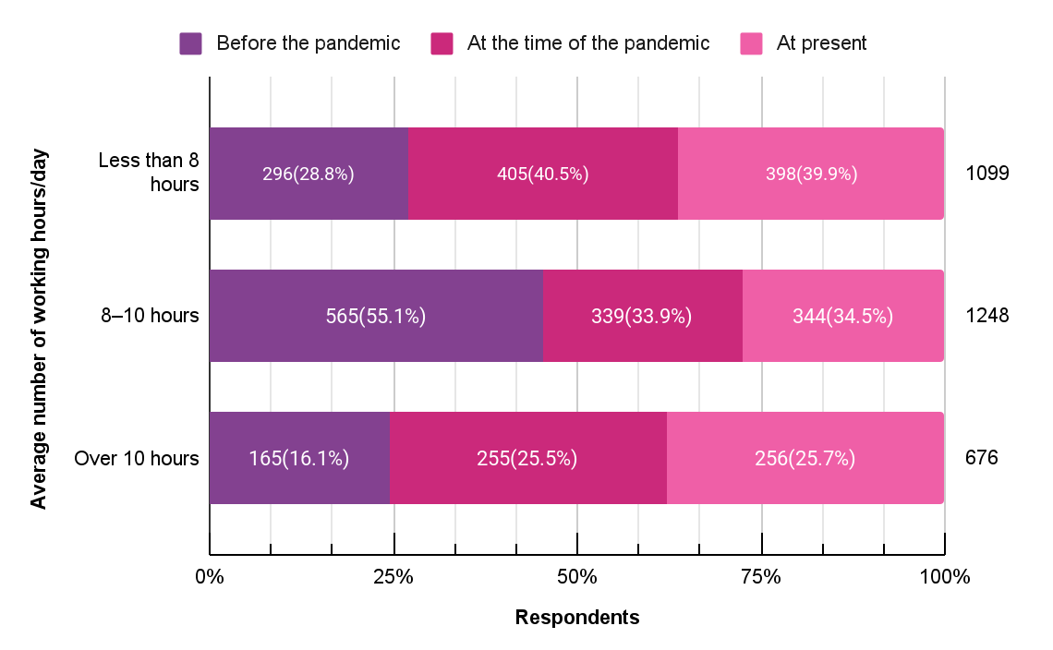
Change in working hours
Notes:
As you can see in this graph, there is a shift in the working hours.Before the pandemic a majority (55%) had worked 8-10 hours. While 16% had worked over 10 hours. In the pandemic period, those who reported working over 10 hours had increased considerably, to 25%.
Specifically for those who reported 8-10 hours of work before the pandemic (565), we saw there was an increase in their hours of work to more than 10 hours for 24.6%.

Slide 8
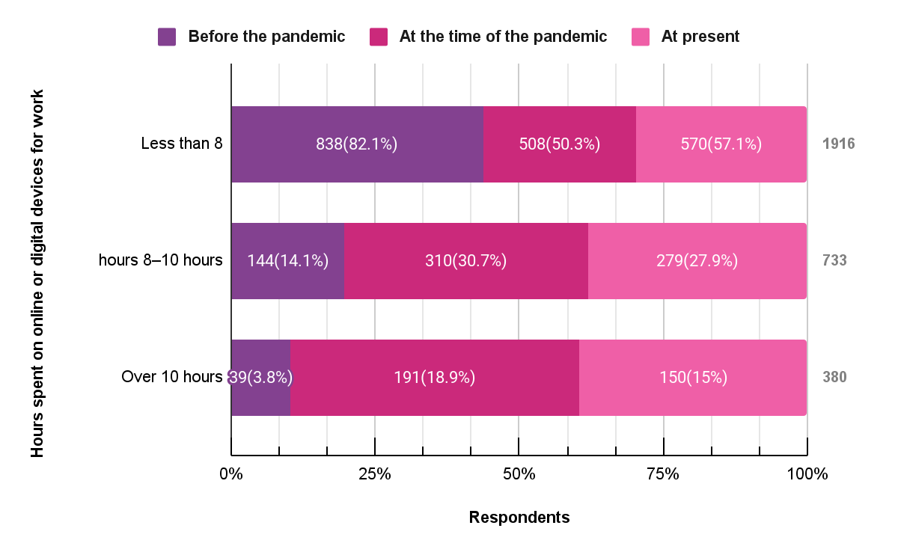
Time spent on online/digital devices for work
Notes:
Use of digital devices for work changed drastically after the pandemic with over 30% using these devices for 8-10 hours and 18% using them for over 10 hours.

Slide 9
Teachers are teaching....from 8-5. They've been entertaining questions and calls throughout the day and throughout the night, because that depends on when the parents are available to communicate with the teacher…
(Union staff, Philippines)
...community and society really need to recognize teachers, for the complex work that they do, it's time that they support us and respect our profession
Teacher, Australia
it's not that teachers are not interested in teaching ...but they are assigned other non teaching assignments...as they are government servants
Union Staff, India
Notes:
The interview participants were able to expand on their experiences of working during the pandemic - the exhausting nature of a teachers’ job, being on calls throughout the the day trying to reach out to students and parents; There was also call for the system to recognise the complex nature of teachers’ work and respect for the profession. The frustration at not having the time to teach because of all the administrative responsibilities - came through clearly.

Slide 10
Economic impact
Worried about losing jobs
Heightened anxiety related to job security
Corresponds with proportion of contractual positions
46.7% stressed about future of career
23.2%
Reduction in compensation
Caused economic distress
25.4% increased expenses due to covid related preventive measures
12.5% increased medical expenses
9.5% reduction in salary/ job losses in family
21.8%
Spent on devices & materials for work & not reimbursed
These included smartphones, laptops & internet devices for 15-17%
54.6%
Notes:
There were overriding economic concerns - it is striking that 23% expressed concerns about losing their job. There was heightened anxiety about job security and 46% clearly said they had concerns about the future of their career. Note that a majority were also mid-career teachers.
21.8% had actually faced some form of pay cut. While at the same time for about 1-4ths there was increased health care expenses. Specifically, 9.5% had faced job loss in their own family
The major chunk of expenses was on digital devices for work. 54.6% had such expenditures not reimbursed by their institution. Included smartphones, laptops, internet devices, etc.

Slide 11
Experiences & concerns about
quality of teaching & wellbeing
Not able to work efficiently
42.7%
32.1% decline in quality of work
Accompanied by concerns about job security
Mode of teaching-learning
was online
23.8%
28.1%
Lack of interactions with co-workers or students - topmost concern
Personal health & safety emerged as top concern
But resources
used were conventional - textbooks
Increased workload for 16%
Change in nature of work for 15%.
Student learning 27.5%
Emotional wellbeing 14.5%
Notes:
Most teachers we interviewed felt that they did not have access to adequate resources online for their teaching and relied on textbooks.
Despite their best efforts 42.7% expressed dissatisfaction with themselves and said they were unable to work efficiently. 32% said there was decline in their own quality of work. The topmost concern for many was the lack of interactions with co workers and their students. This was followed by concerns about increased workload and change in nature of their work.

Slide 12
teachers are not used to using the new platforms. The platform itself is not well organized to be used
Teacher, Japan
...not all students are attending zoom classes, as their parents cannot afford to pay for data ...these students are provided with hard copy of the worksheets, we contact the parents and handover the copies
Teacher, Fiji
Most teachers in remote areas have limited internet access. Teachers in the remote areas, or even in the city require laptop with high storage to save students work. All teachers need more budget for internet.
Union staff, Indonesia
Notes:
The dissatisfaction with their quality of work comes across in these statements from teachers we interviewed. They speak of parents who could not afford data. It was the teachers’ who asked parents to come to the school and provided the hardcopies of worksheets. For teachers too the digital platforms were new and unfamiliar and not very conducive for teaching. The teachers themeseves were in remote areas with connectivity issues, they did not have requisite devices or storage in their computers.

Slide 13
Access
ICT Competencies
43% laptops/ computers
Lowest availability in South Asia
Increase in use of digital devices, online modes
4.5 times video contact
2.7 times learning management systems
1.8 times digital learning software
33.7% smartphone
Most accessed in South Asia
Devices provided by institutions
North Asia - 69.3%
South Asia - 27.4%
Ranking themselves advanced beginners or novices
43.5% digital skills
41.5 % laptops, device most needed for work
Internet
80.4 % challenging
Notes:
All of what we presented so far clearly shows the reliance on digital and online medium for teaching during the pandemic. So if we see in terms of actual access we find that 43% respondents had laptops or computers; 33% used smartphones as their device for online / remote work. There was quite a bit of regional variations in this regard - The proportion of those mostly using smartphones for work was quite high in South Asia at 36.9% followed by South East Asia at 28%. Devices were mostly provided by the institutions in North Asia 69% low of 27% in south Asia.
Accessing internet for work is the most challenging thing for over 80%.
Despite these limitations the permeation of digital technologies is quite high. There has been two fold or 4 fold increase in use of digital softwares and learning management systems. Conversely the self assessment shows that most people ranked themselves as either novices or beginners in using the technologies.

Slide 14
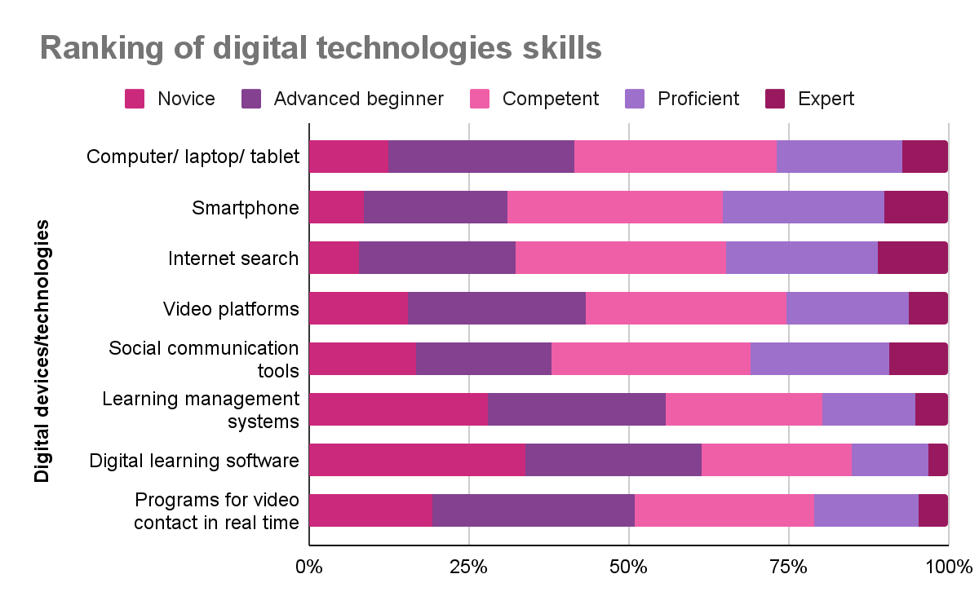
Notes:
We can take a closer look at the self rating of competence in digital technologies and skills. For smartphones and internet search most have rated themselves as competent or higher. But for the remaining, including computers and laptops, and other kinds of digital technologies, a majority have ranked themselves as novices or advanced beginners. The contrast here is quite stark. There is high permeation and demand for use of digital technologies and ed tech platforms but the access to appropriate computing devices and competence in using these are quite low.

Slide 15
Professional development opportunities
67.6%
80.6%
55%
27.8%
Learnt on their own, with some help from others or at their own cost to use digital technology
Lack of professional development opportunities was a challenge
Availed professional development in using digital technologies
Received professional development opportunities from their institutions
Highly challenging 24.9% +
Somewhat challenging 55.7%
37.4% had not received any such training
Govt departments 21.2%
Unions 12.2%
Despite low level of self reported competence
Notes:
How much were they supported with professional development opportunities in using the devices and education technologies for work? We see that about 67.6% learnt on their own. 80.6% shared that lack of professional development was a challenge for them.
55% did say they had availed professional development - 27% of them had received this from their own institutions.
So clearly there is a large gap between the professional development needs and provision.

Slide 16
Lower
the competence & professional development opportunities
Higher
the fear of being unprepared for work in future
Notes:
There were two aspects the survey touched upon - their self competence and fears about future of work. We compared these two responses and find that among those who reported fears of being unprepared for the future of work, a large percentage had also reported themselves to be novices in using digital technologies.

Slide 17
Support for teachers in their online/remote mode of work
“being a part of union allowed to have a strong organised presence and to collectively raise issues with concerned authorities”
Peers / Colleagues
Job losses, pay cuts, health care, professional development, internet allowance, purchase of devices
Biggest support from colleagues experiencing similar hardships; could share and learn from knowledgeable peers
Union
Health emergencies, professional and legal support
Salary-related issues, curriculum changes for teacher’s education - India
Curriculum reduction for students - Australia, Indonesia
Online parent-teacher meetings, loan availability- Fiji
Non-teaching days, training support - Australia
internet budgets - Indonesia, Malaysia, the Philippines
Family members
Digital skills and support during online teaching
Emotional support
Notes:
There were three sources of support reported by our participants - the majority was peer support and support of family members. And support from their respective unions.
Peer networks emerge as quite invaluable in providing quick support both at the personal and professional fronts during the challenging times.
Being part of the union gave members a sense of community, voice and at times legal redress for issues such as job losses and pay cuts. Paring down the syllabus, budgetary allocation for internet was achieved in some places.

Slide 18
..not only the teachers who are teaching but those who are at home and not getting work.. .need to get basic help from the government and school management for their survival...
Union staff, Nepal
Teachers need to get enough training in technology and they need to be confident that they are in their job without any disturbances and fear of being terminated from the job, such stress should not be there
Union staff, Nepal
The role of teachers will continue they will have to adapt and grow along… teachers of the future must be prepared to be data collectors as well as analysts, planners, collaborators, and curricular expert problem solvers
Union staff, Malaysia
Notes:
Participants in interviews were quite vocal in sharing the concerns and areas where they needed support. Clearly, they felt teachers must have job security and freedom from constant worries of job loss. There is need to reimagine the roles of teachers for the future and make sure they are being prepared accordingly.

Slide 19
Respondents with direct experience of teaching
Sources of professional support
Formal avenues for professional development emerge as a high priority
For a majority of respondents (53.9%) teaching learning with respect to managing and orchestrating digital technologies was a high priority
30% individual efforts by reaching out to colleagues
21% their institution
20.1% unions
14.3% professional groups
Notes:
There was a section in the survey for those with direct teaching experience during the pandemic. For many, professional support was absent - they had to get issues addressed through individual efforts or by reaching out to the peer group. It was the expertise within the peer group that emerges as the main source of support. Some had Institutional support, support from union and professional groups.
It is not surprising that formal avenues for professional development in nearly all aspects of digital technologies for teaching and learning emerge as a high priority for teachers.

Slide 20
Respondents with direct experience of teaching
Games
Group messaging on WhatsApp Telegram
Used Padlet MentimeterKahoot
Hands-on activities
Teachers created, curated videos & audio content
Involved parents
Small groups
Notes:
Once again despite severe limitations teachers shared strategies they had devised, resources they had used and content they had curated to ensure their students had a good interactive learning experience online.

Slide 21
Future of Work
Main concerns for who were ‘not prepared for the future of work’,
increased workload
lack of interactions
change in nature & content of work
Requirements for future of work
professional knowledge
technical support
access to ICT devices
88.4% digital technologies would continue into future of work
25.4% well-prepared for future of work
Notes:
The almost unanimous view of those who took the survey was that digital technologies are here to stay. Conversely, only 25.4% said they were well prepared for the future of work.
The main requirements for the future of work was professional knowledge, technical support and access to ICT devices.

Slide 22
4.Recommendations
Access to digital devices for work
Better pay & health insurance
Professional development in digital technology
Recognition of teacher communities
Recognition for teachers’ work
Involvement of teachers and their unions in social and policy dialogue

